Slide 1
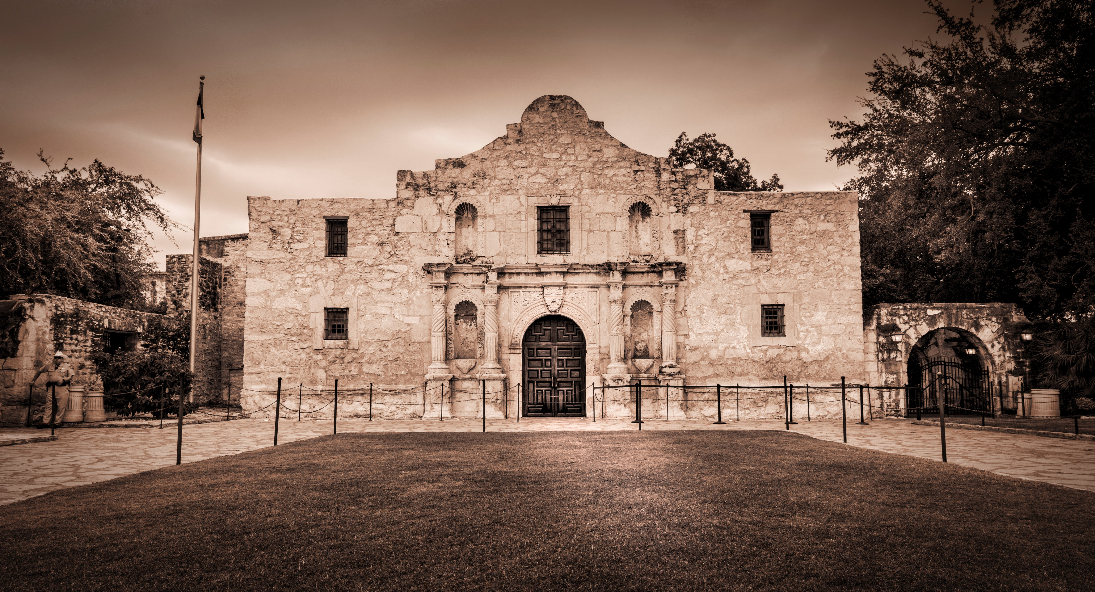


Slide 2

Notes:
Greetings/additional statements - Title

Slide 3
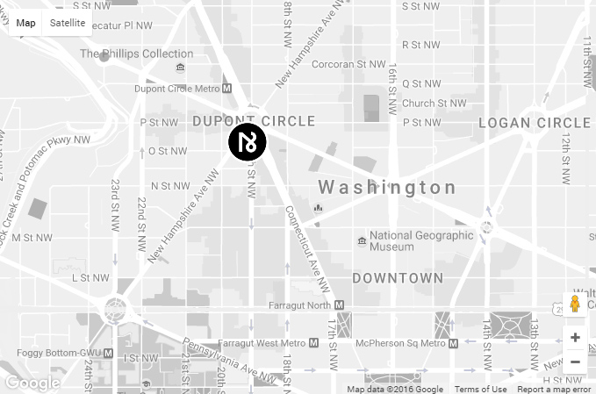

Notes:
(Innate location) In Washington, DC (national capital) in Dupont Circle district

Slide 4
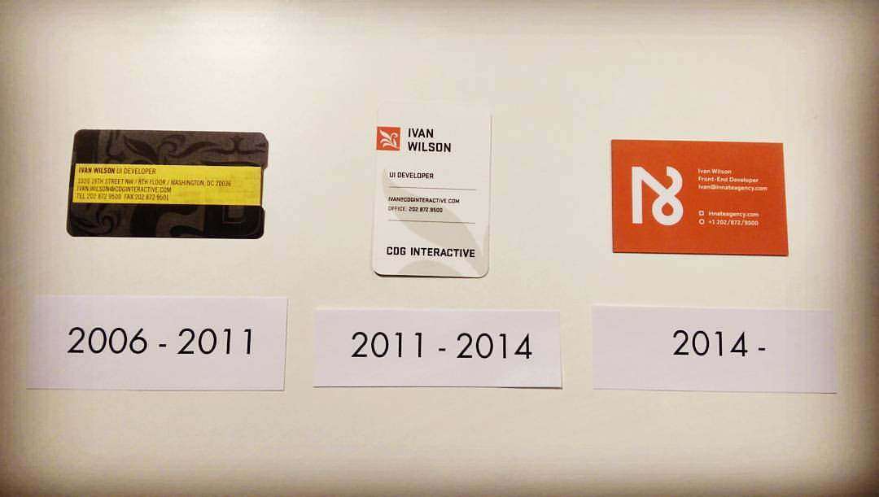
Notes:
10th Anniversary in April

Slide 5

Notes:
Travel Insurance
What is travel insurance? (Ask audience)

Slide 6
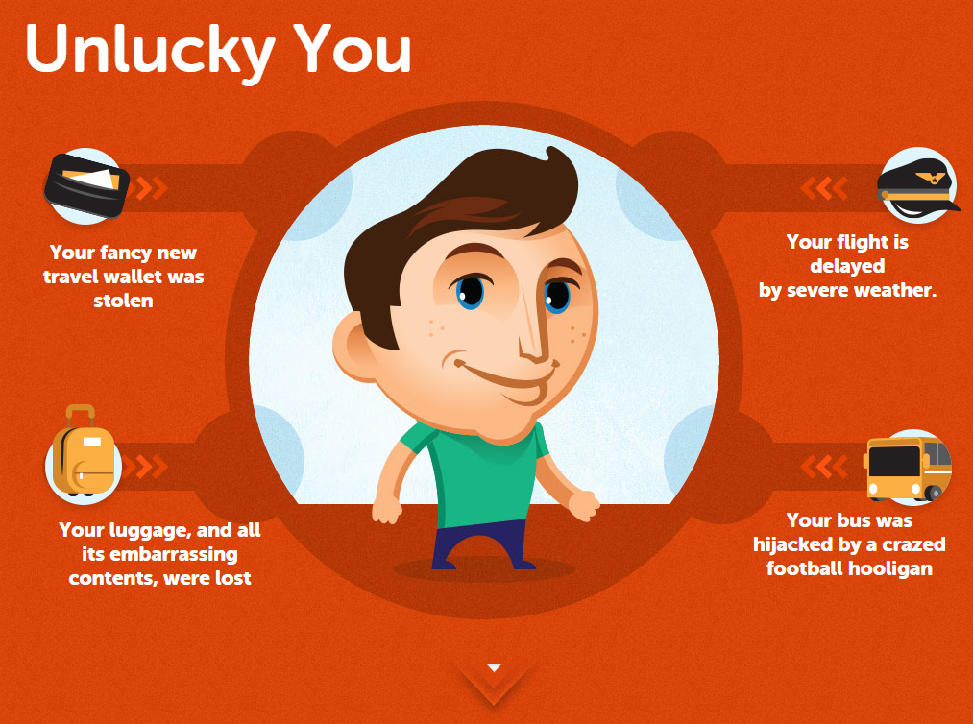

Slide 7
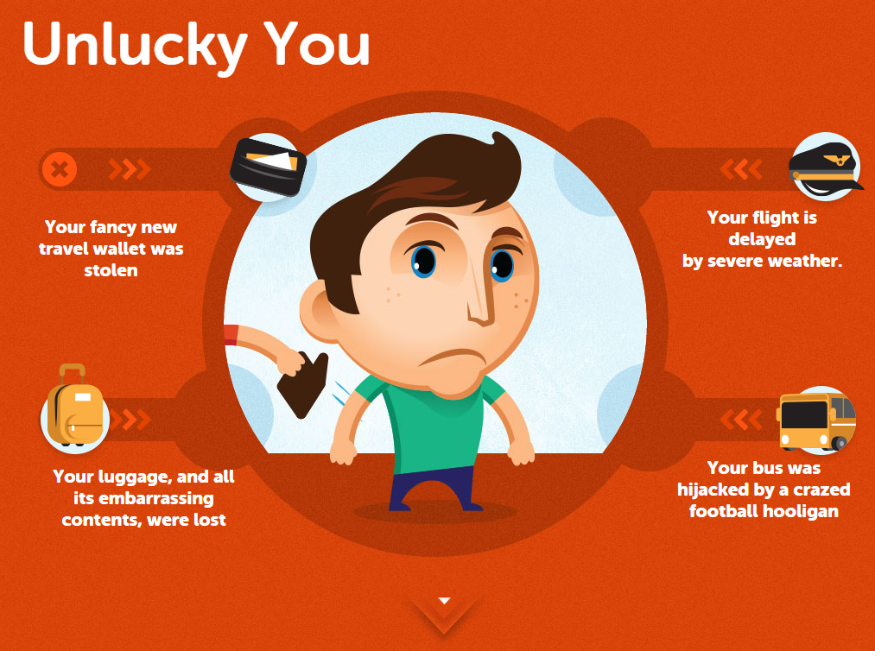

Slide 8
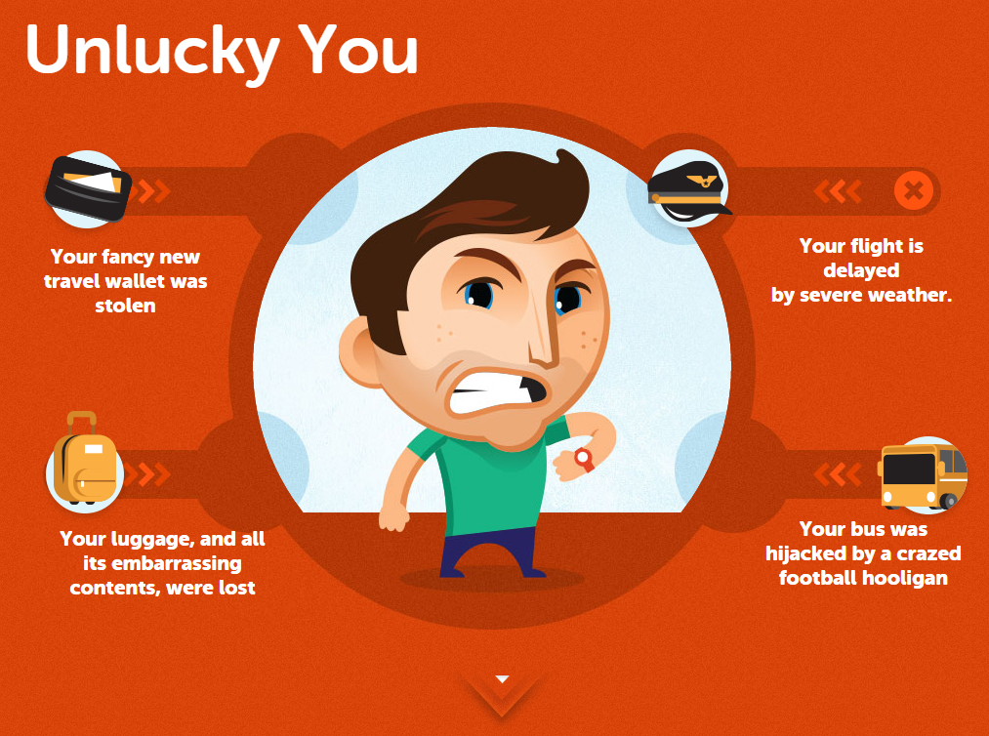

Slide 9
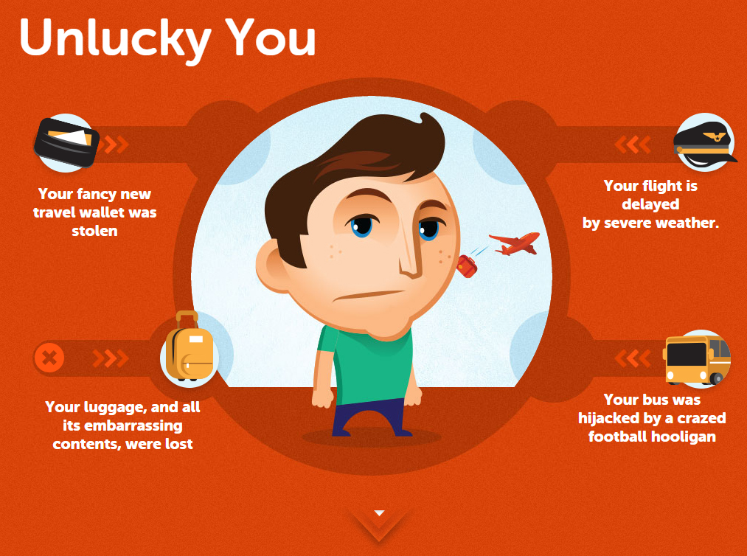

Slide 10
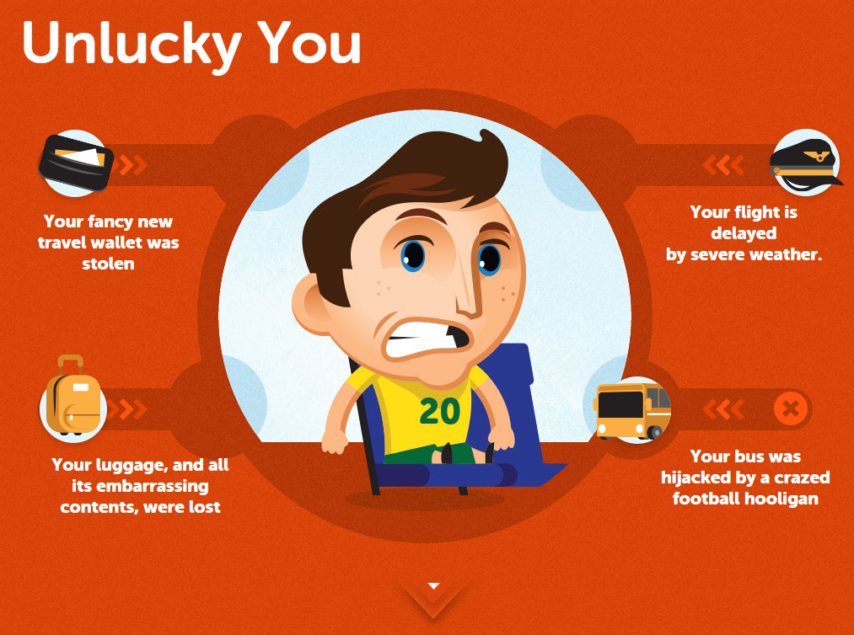

Slide 11
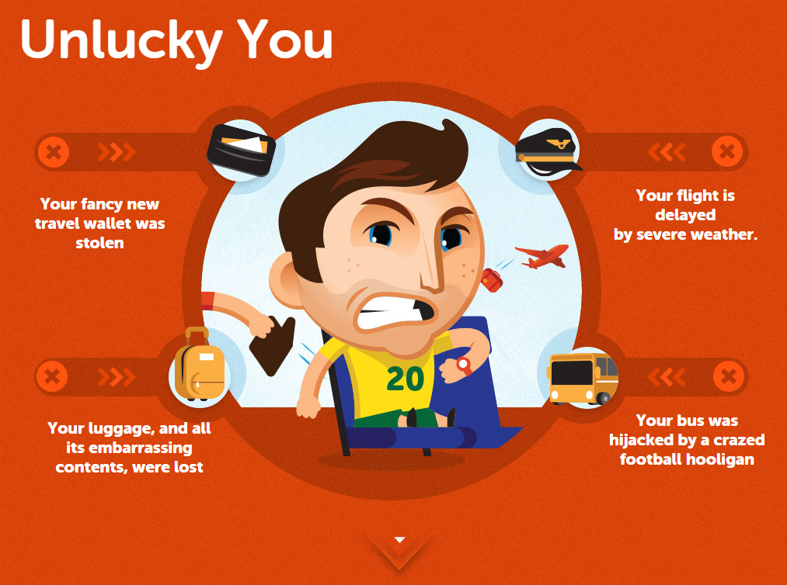

Slide 12


Slide 13
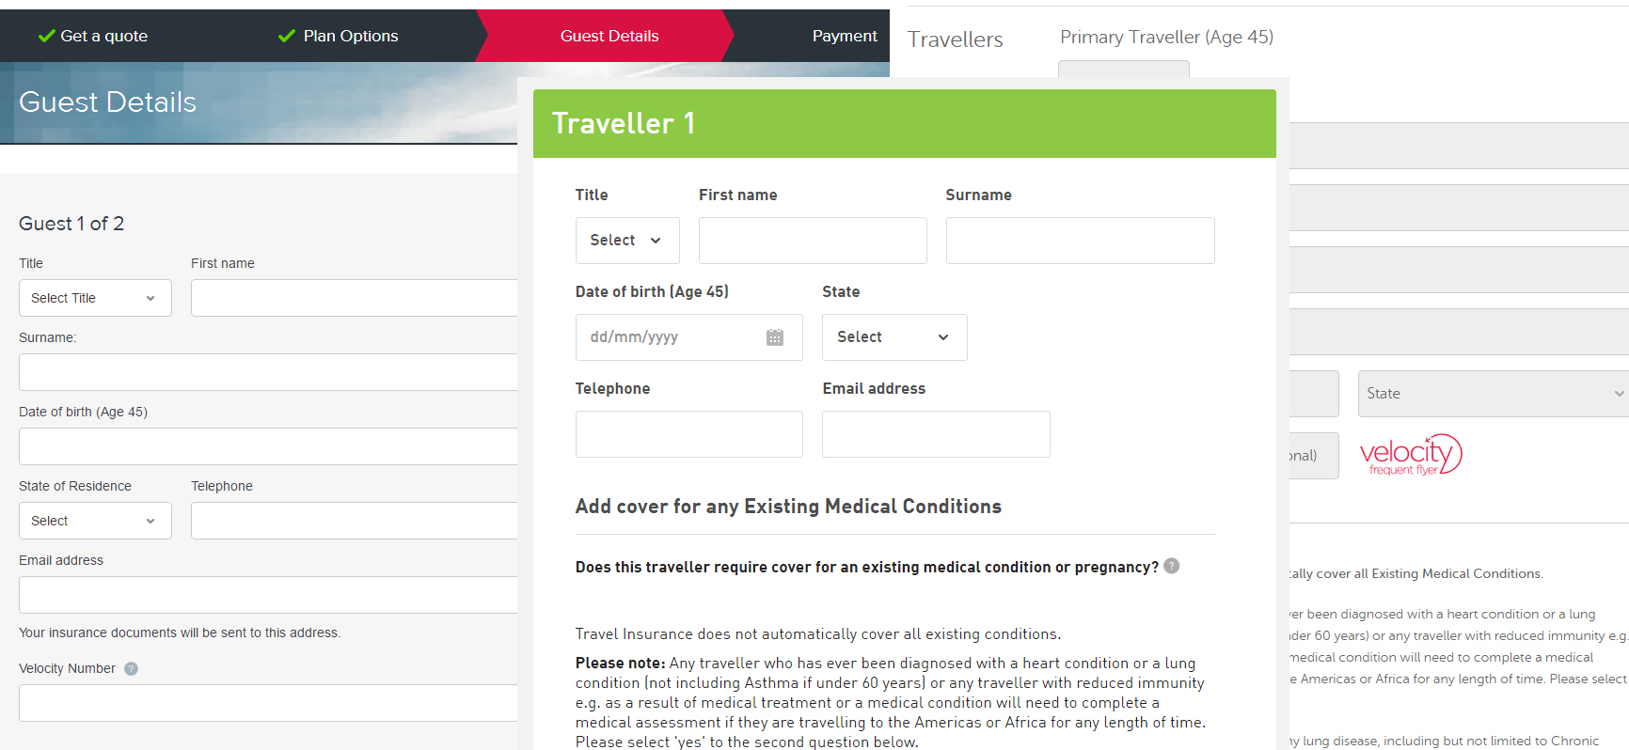

Slide 14
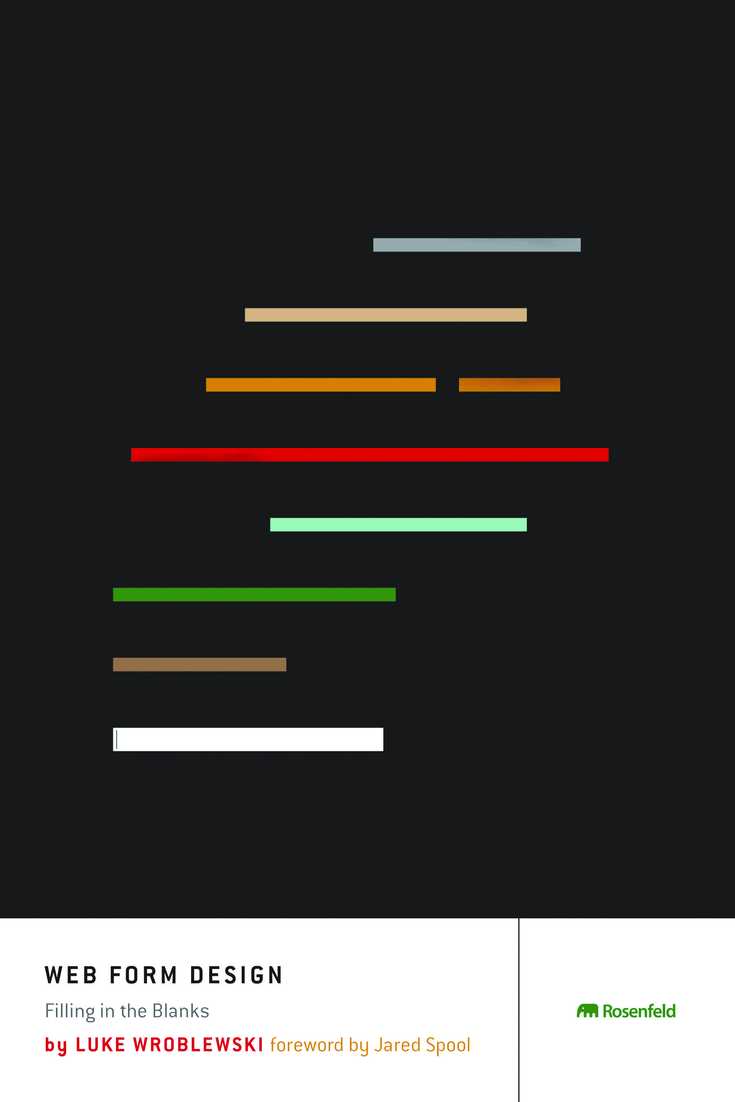

Slide 15
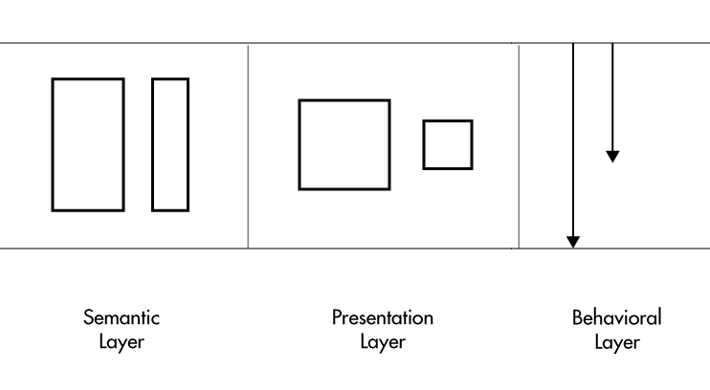

Slide 16


Slide 17
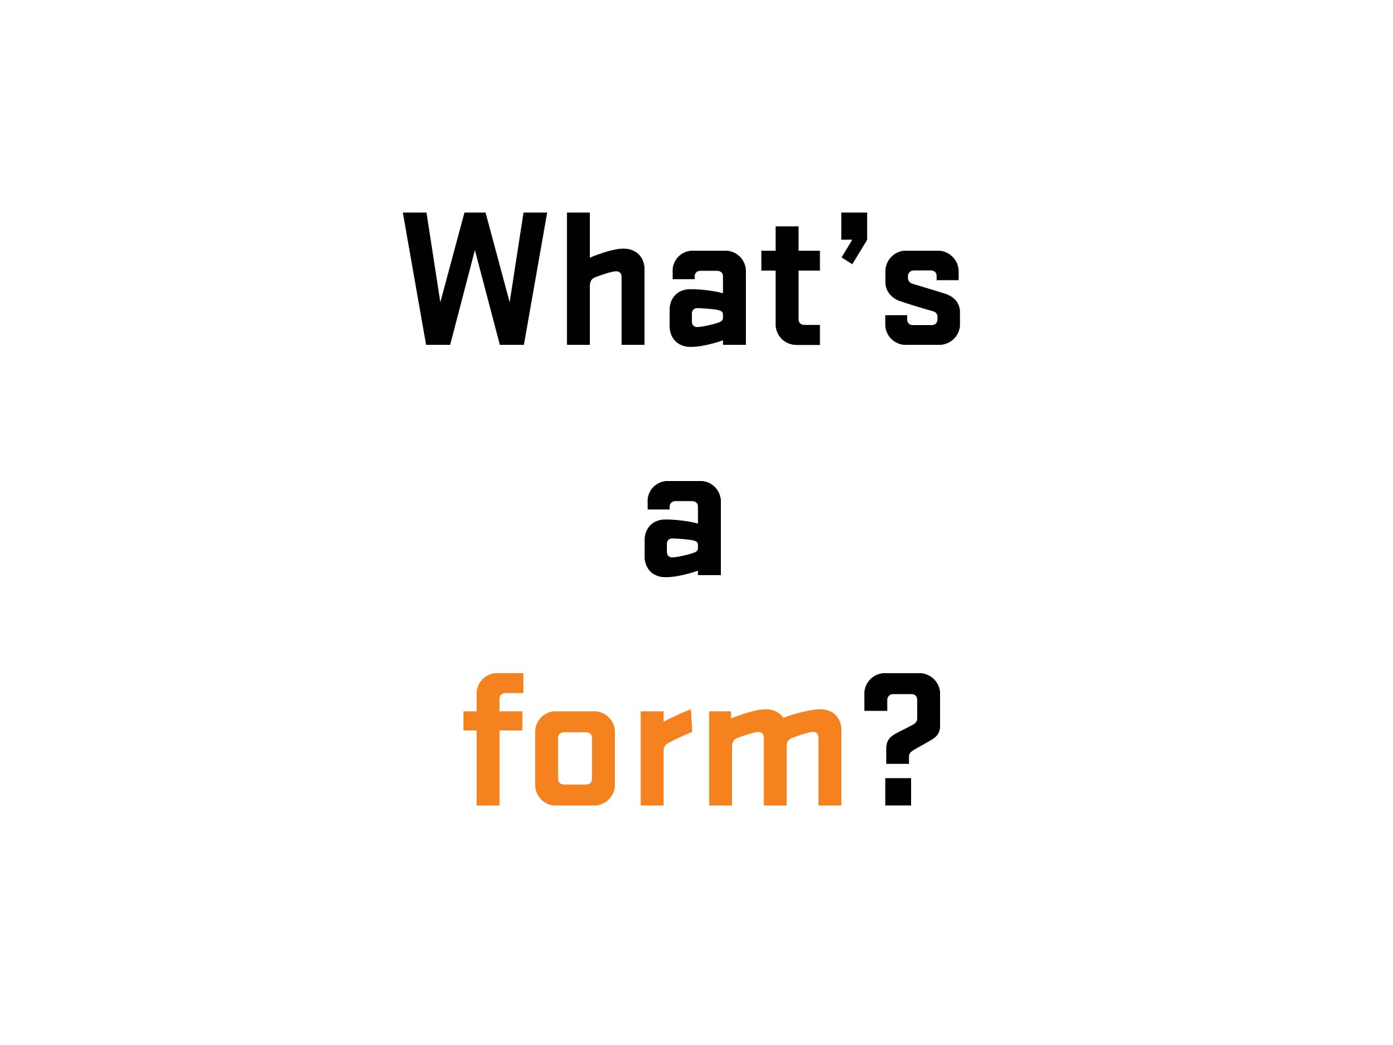

Slide 18
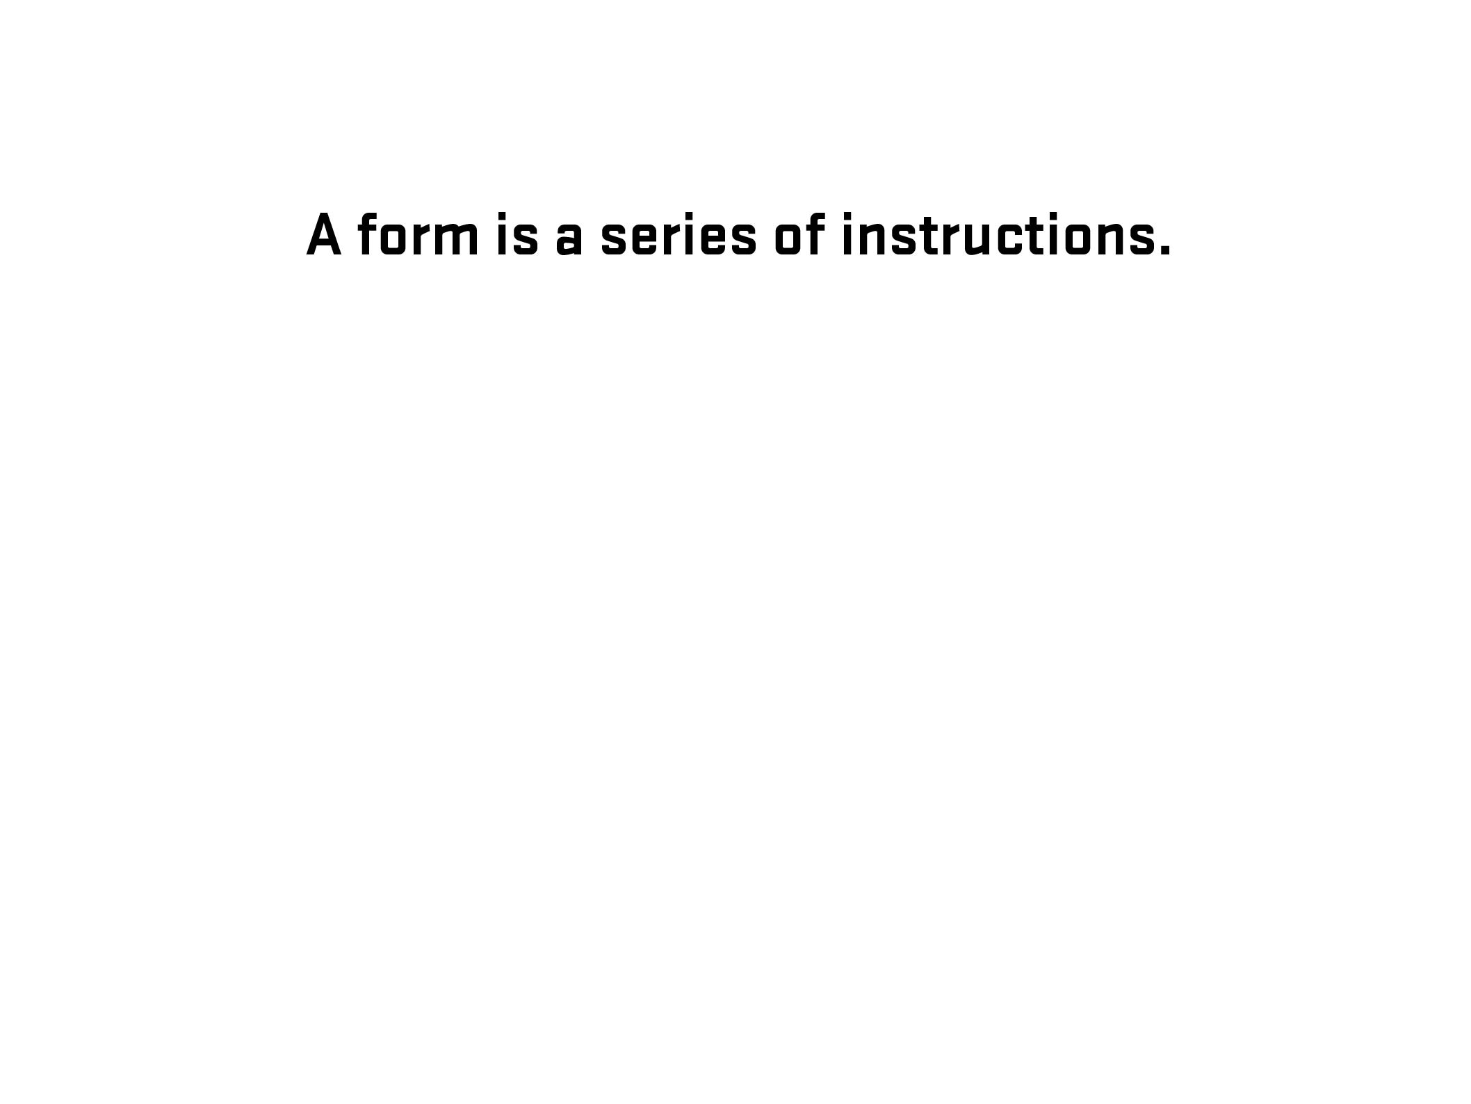

Slide 19
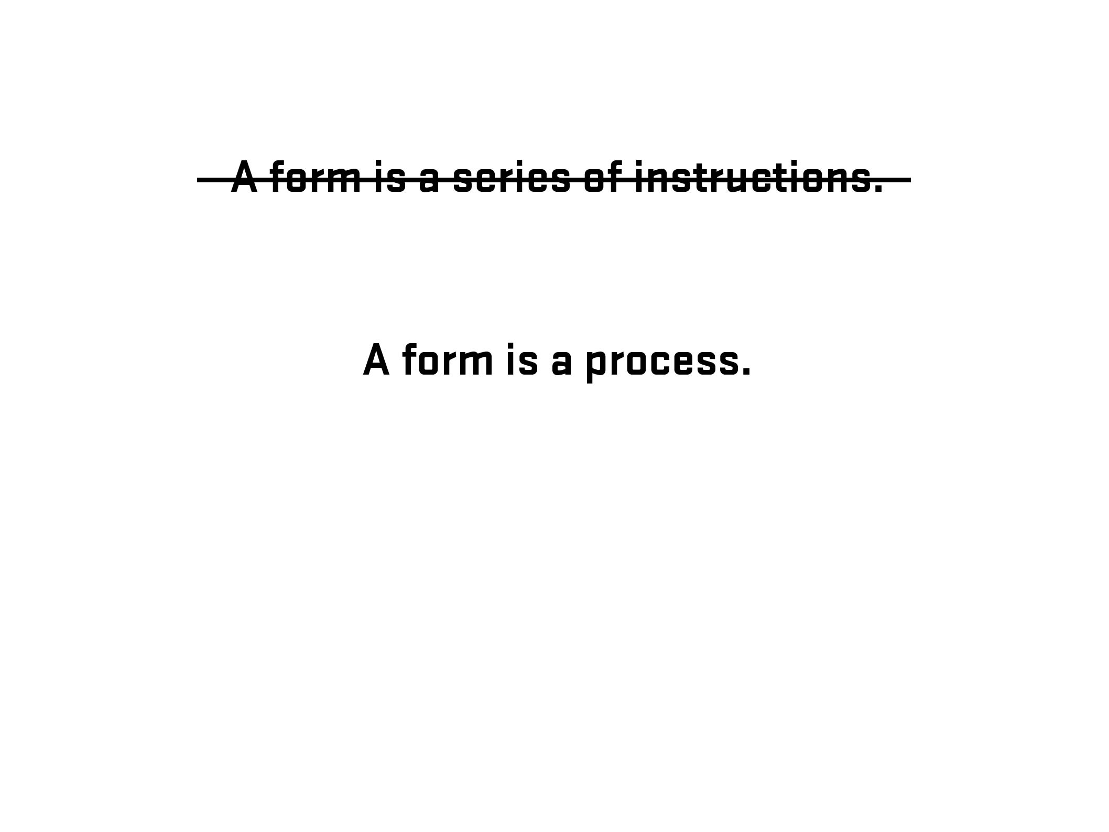

Slide 20
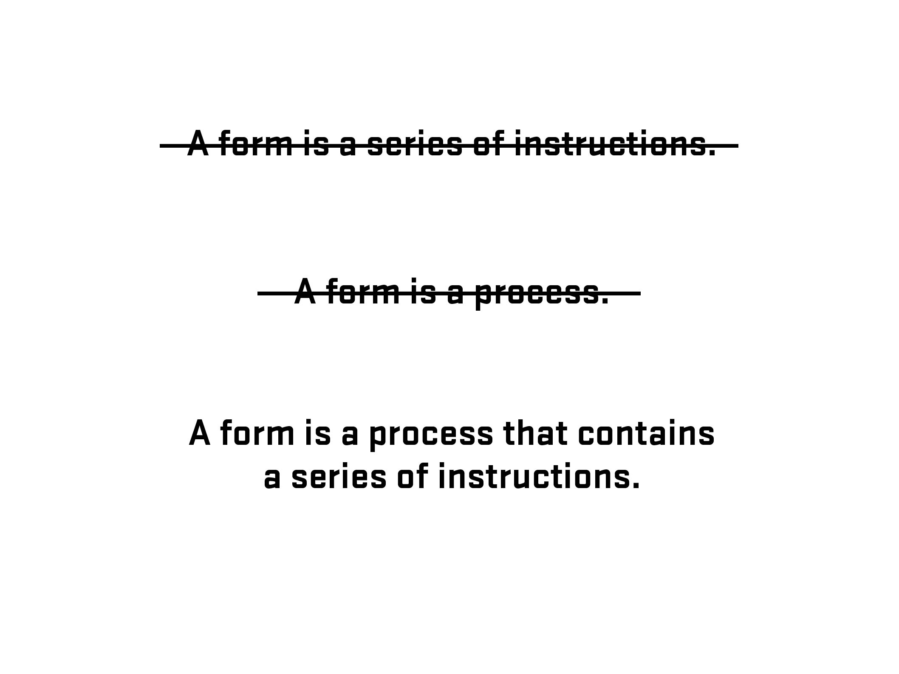

Slide 21
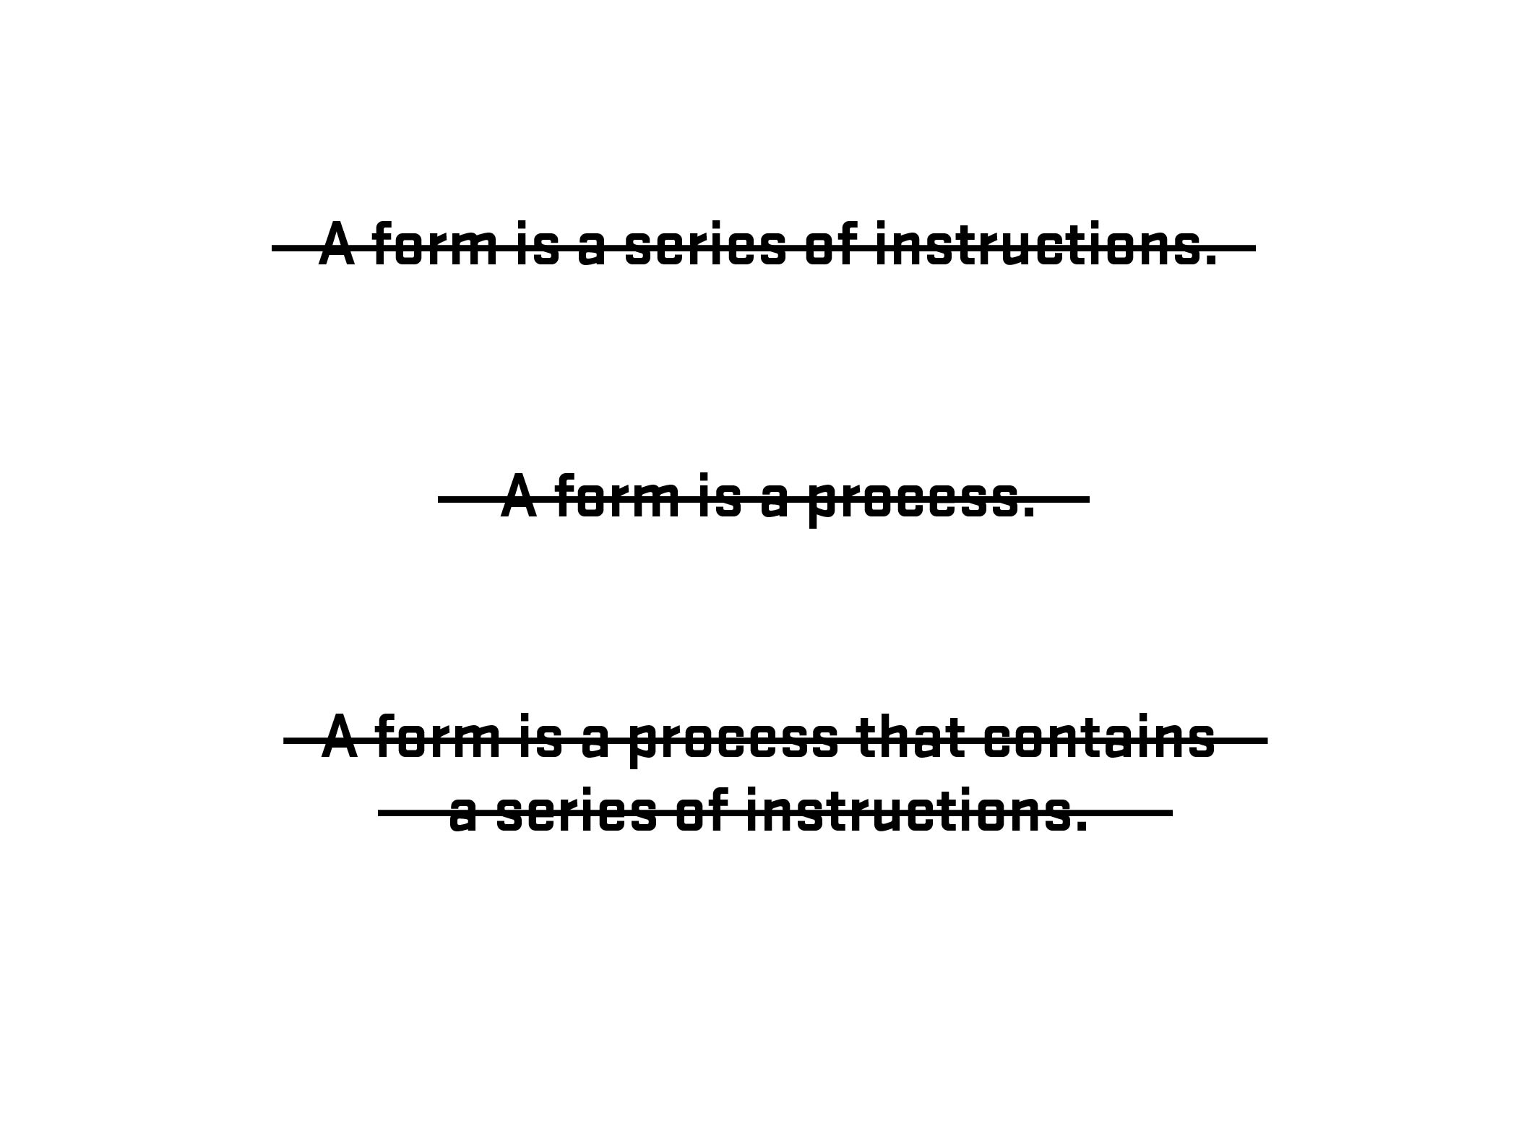

Slide 22
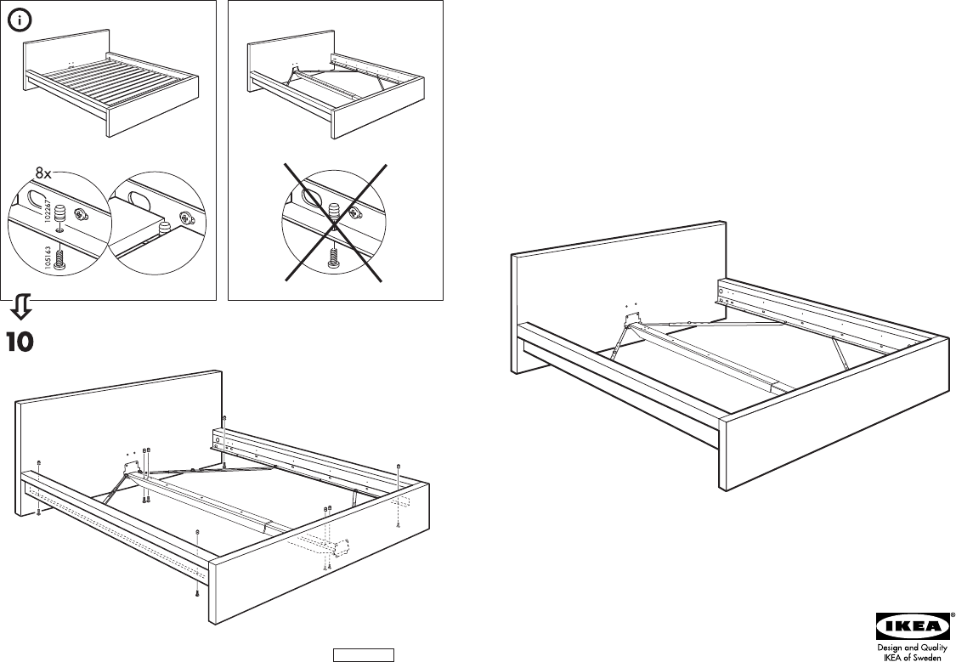

Slide 23
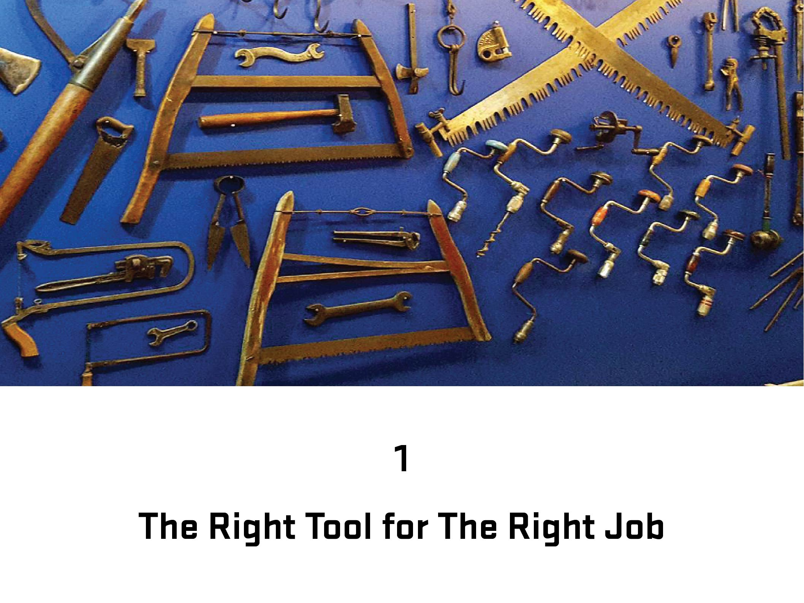
Photo – Space Lab, Vancouver, Canada (Clint Moroz)

Slide 24
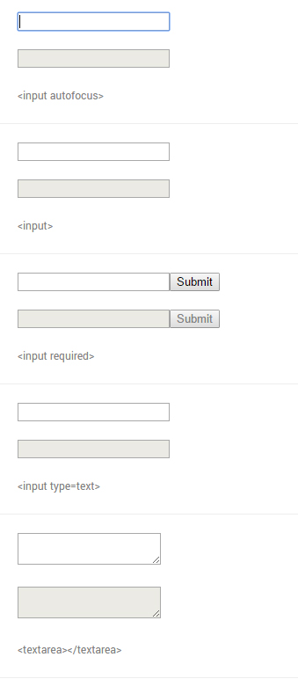
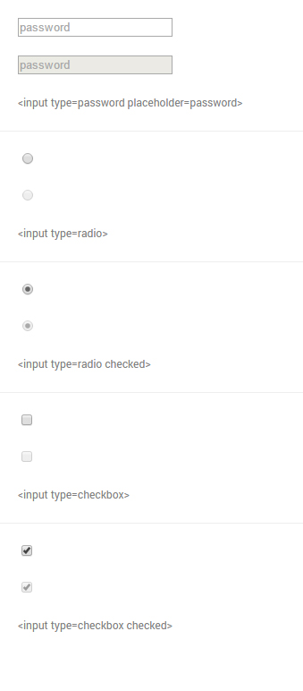
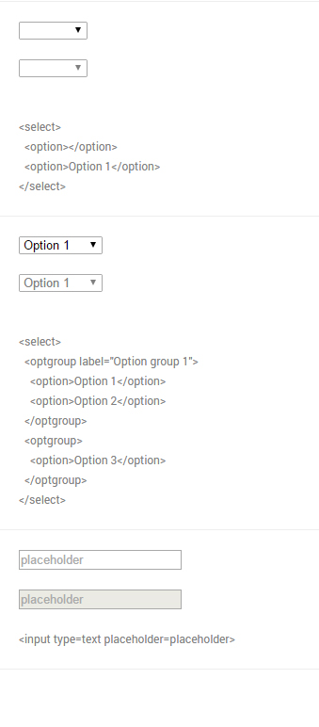
From Native form elements (http://nativeformelements.com/) - Joshua Jenkins

Slide 25
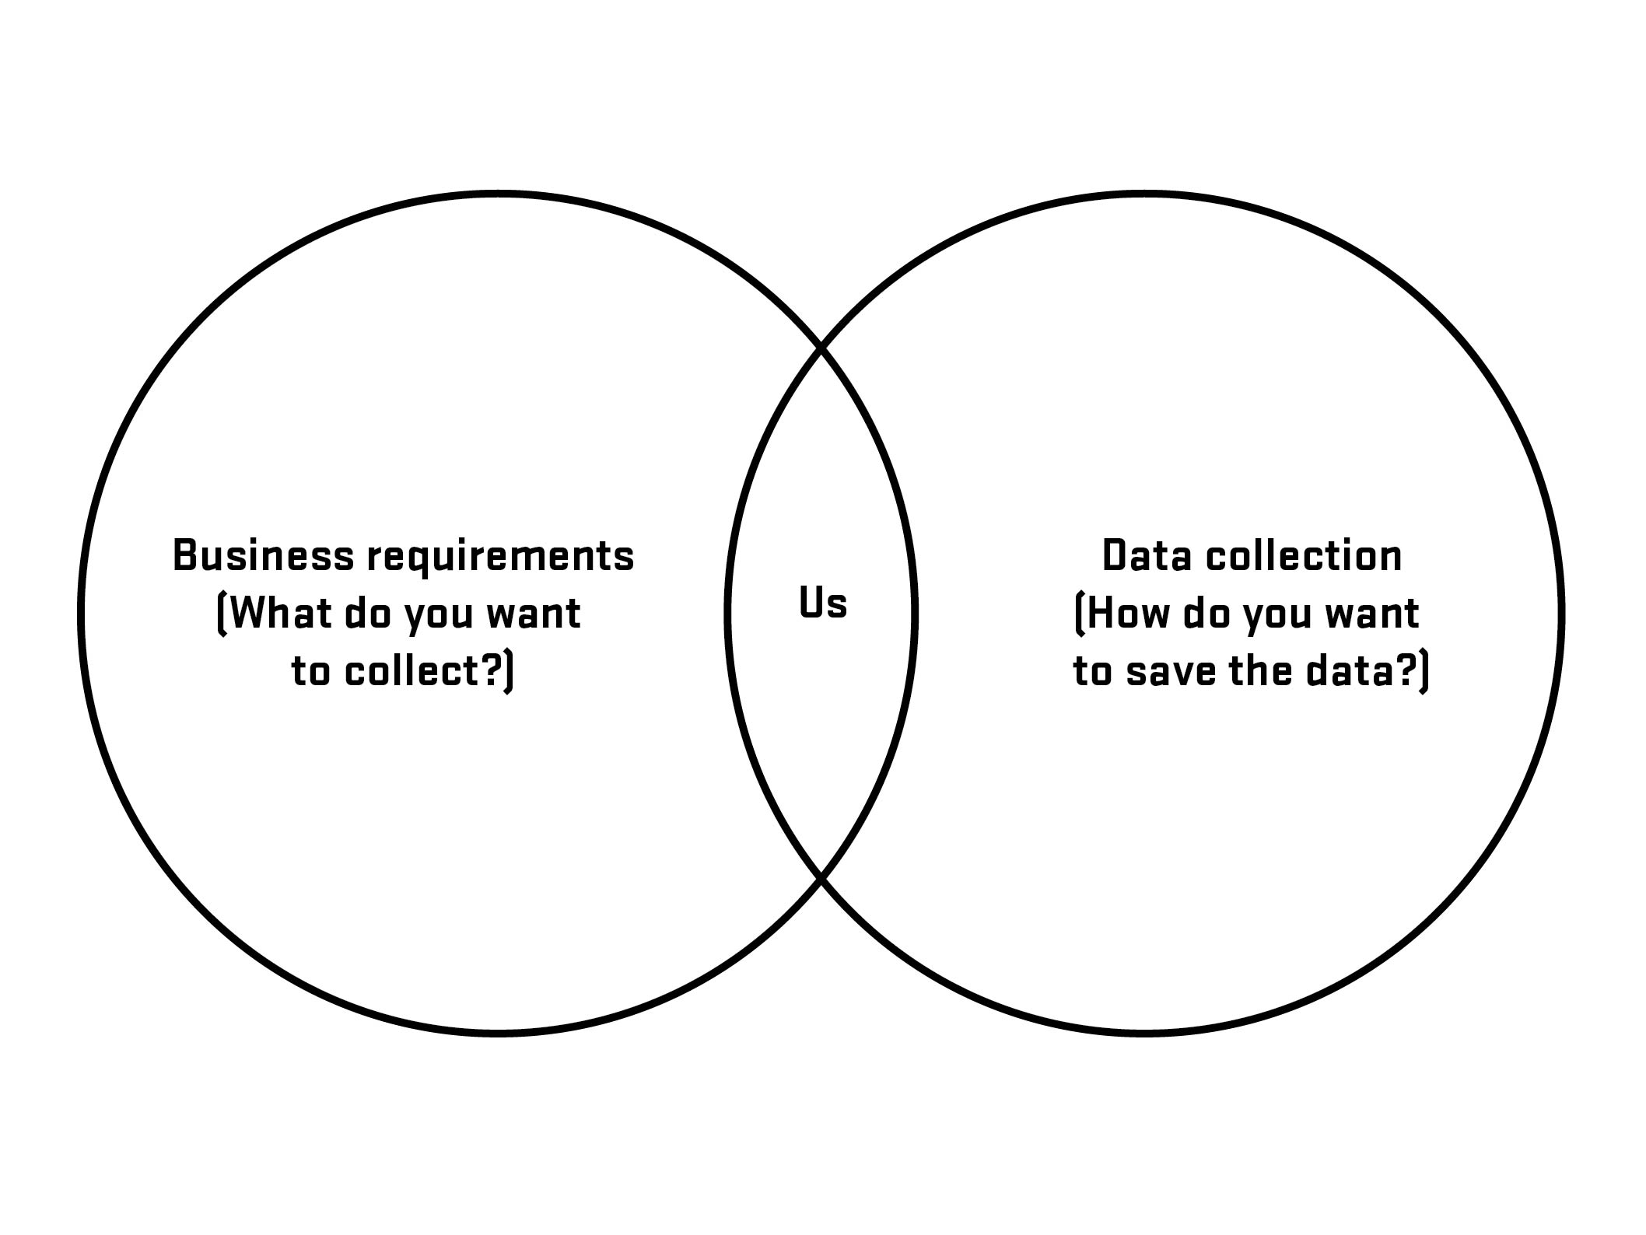

Slide 26
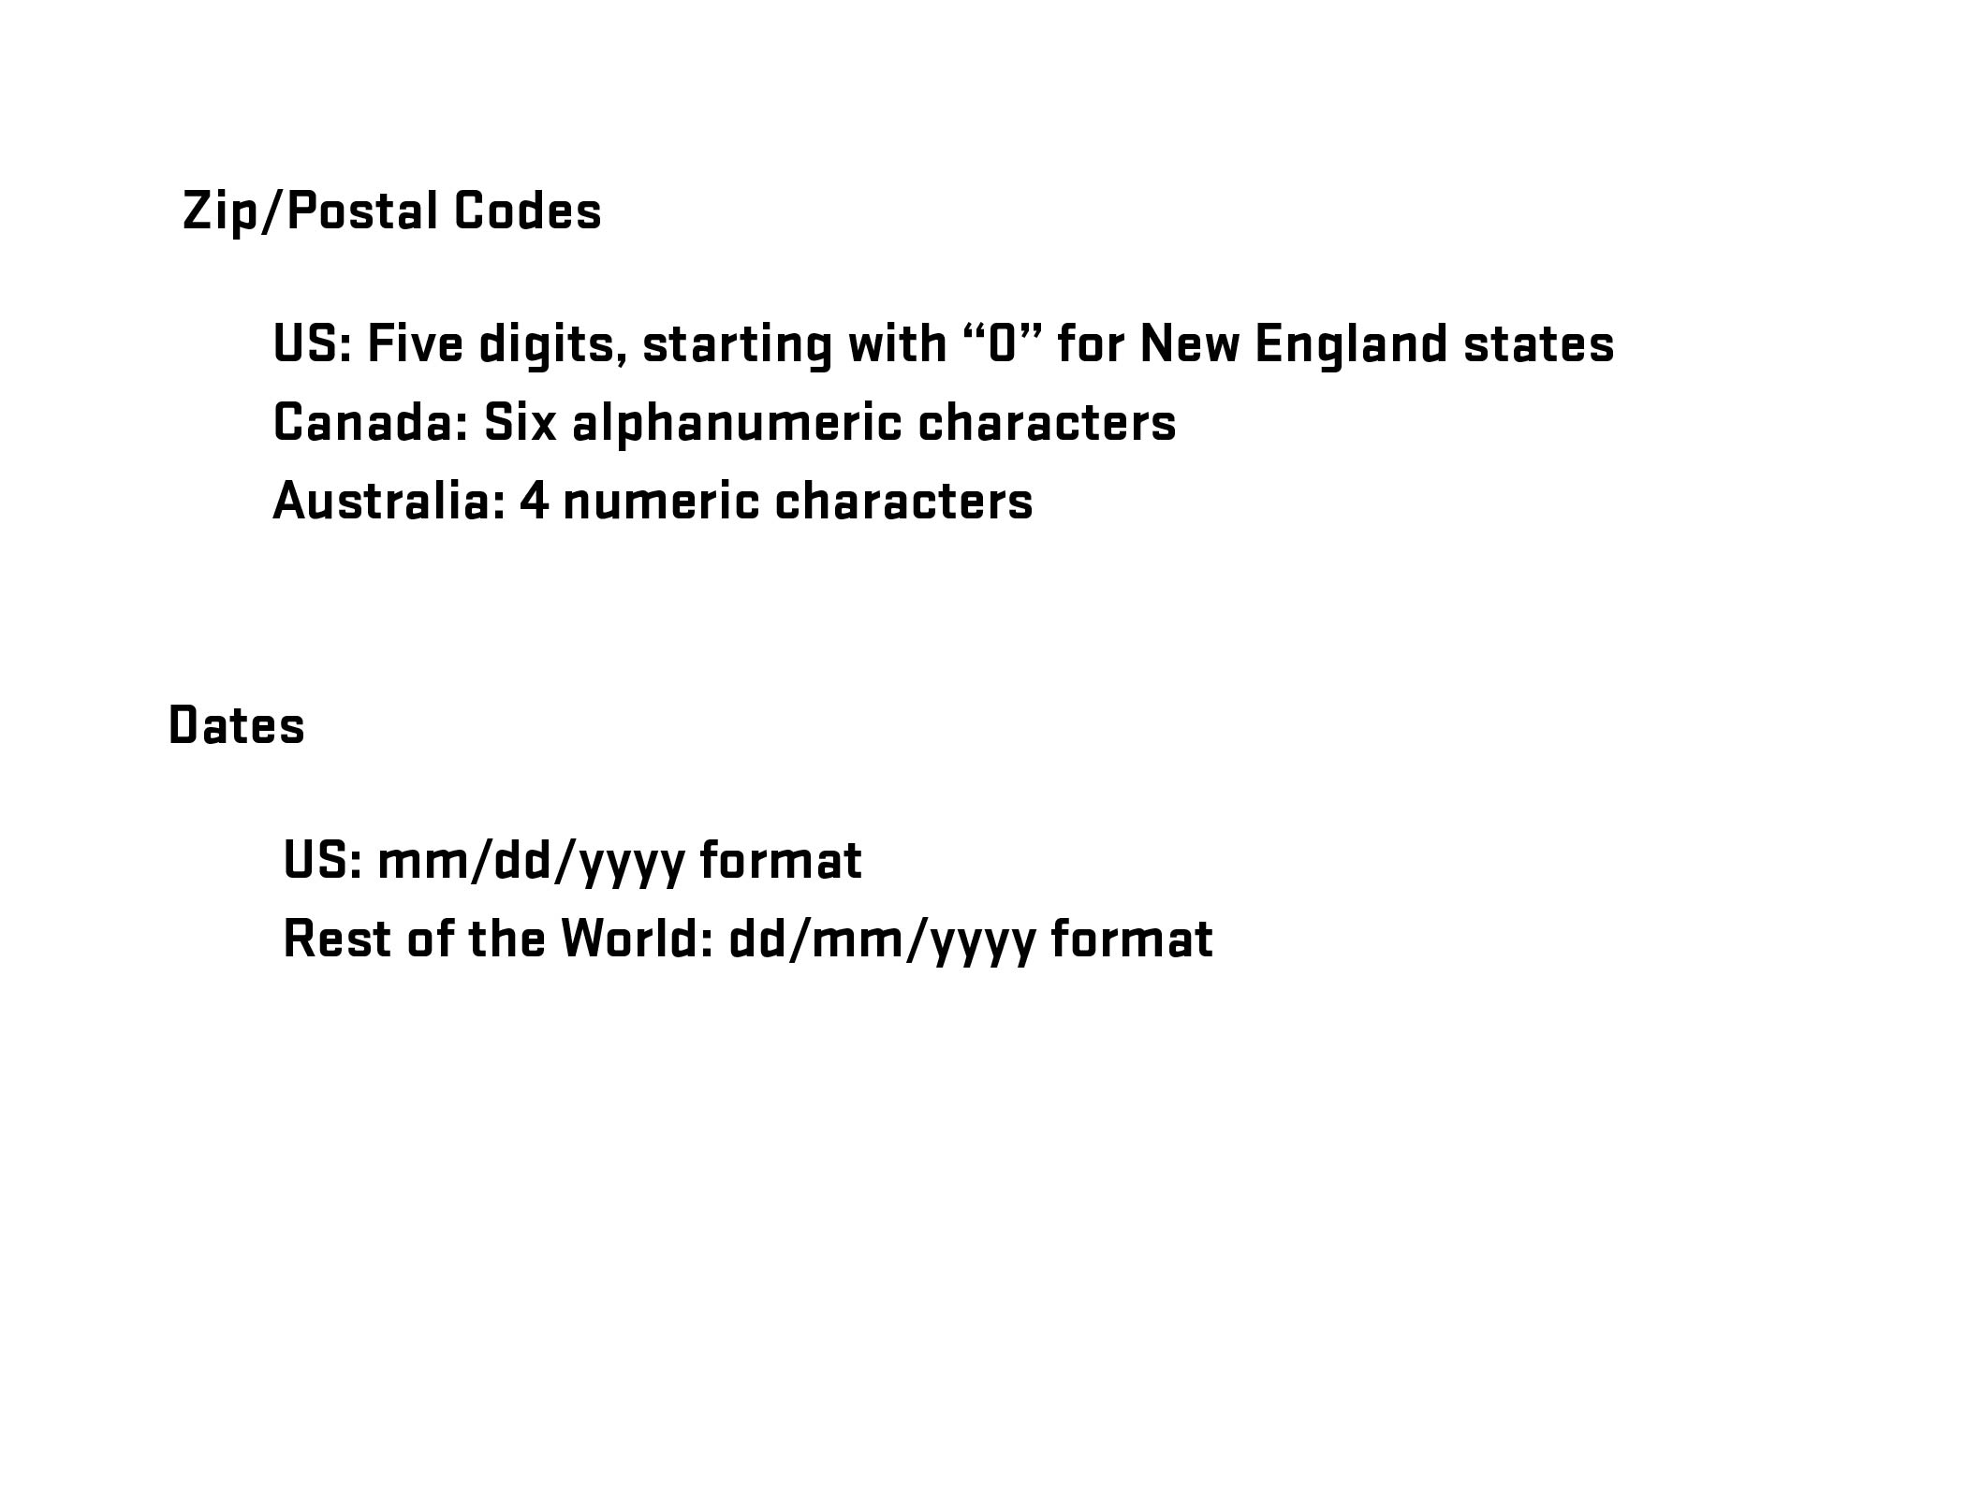

Slide 27
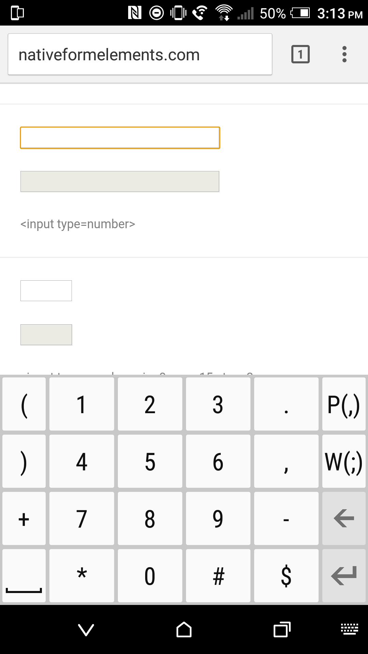


Slide 28
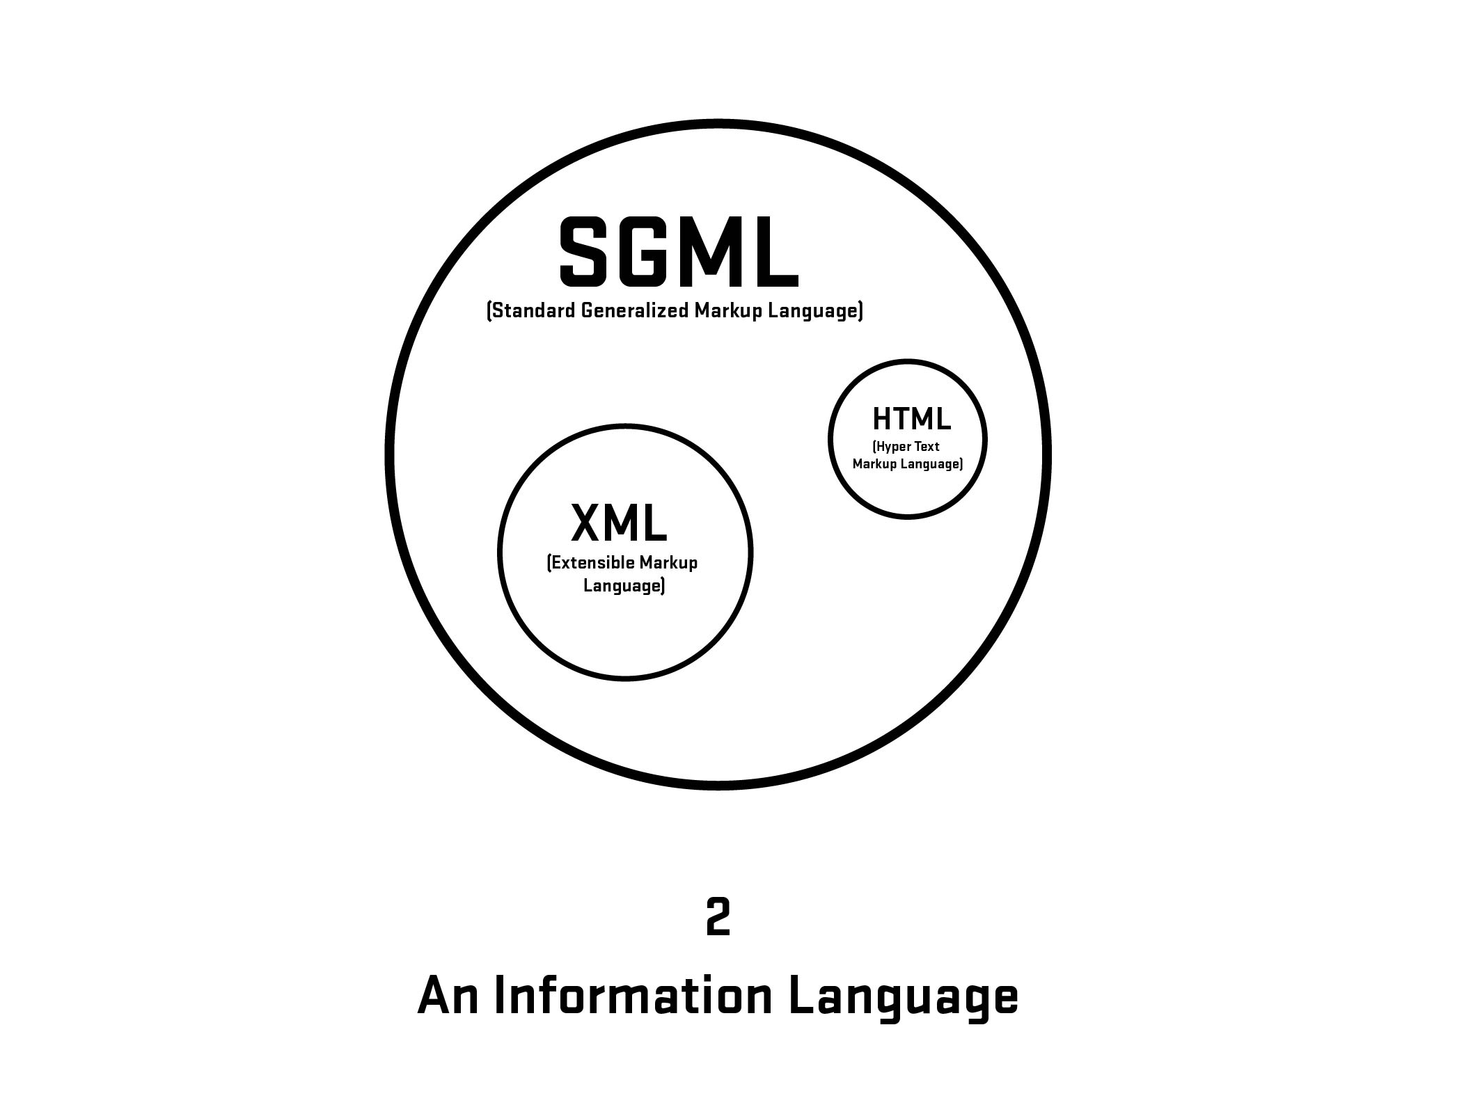

Slide 29
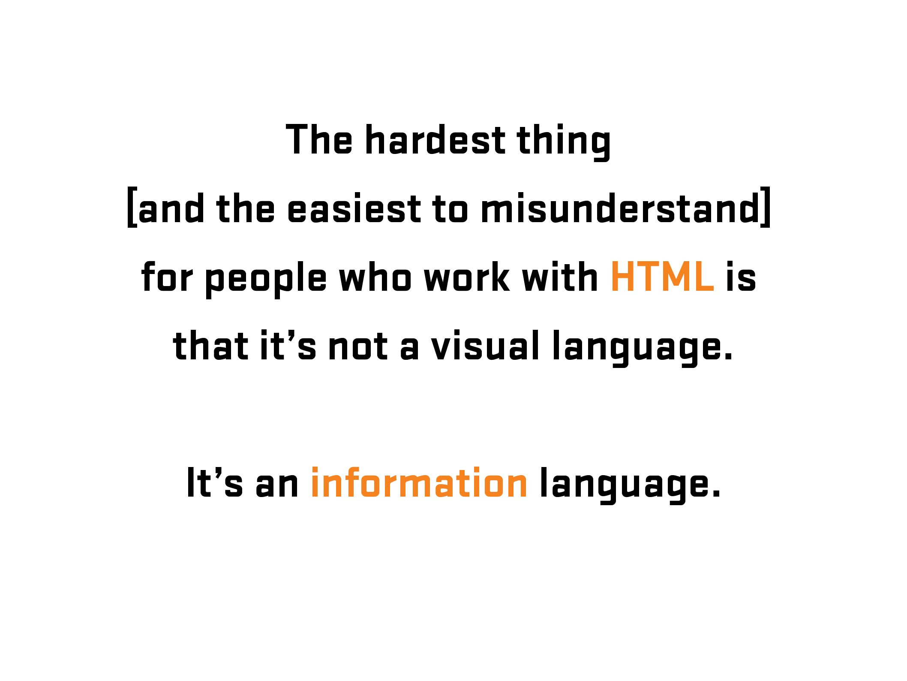

Slide 30

More Information: https://en.wikipedia.org/wiki/Kaieteur_Falls
Notes:
Kaiteur Falls, Guyana

Slide 31

Notes:
Kaiteur Falls, Guyana

Slide 32
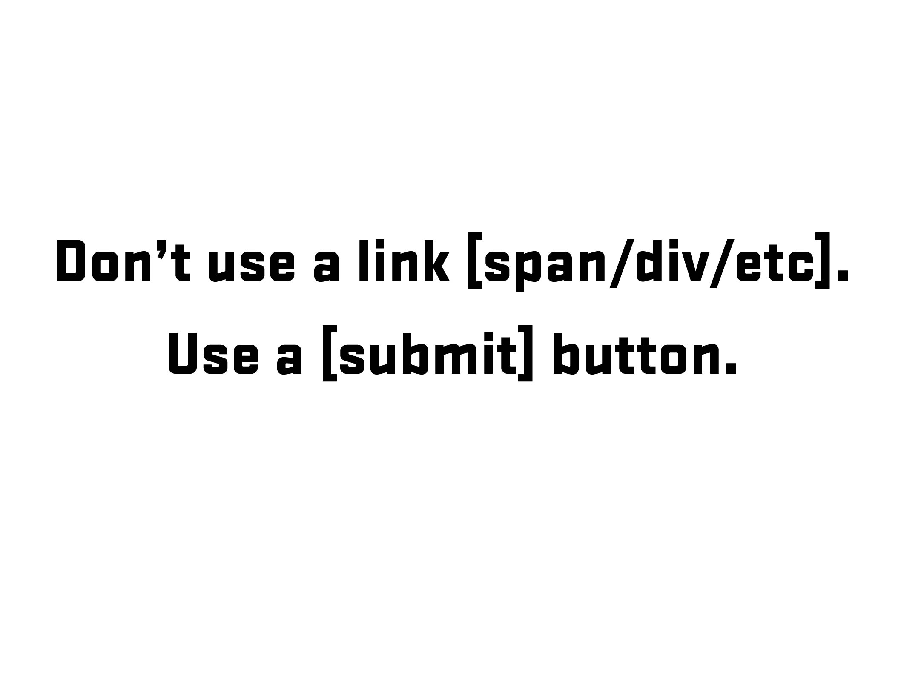

Slide 33
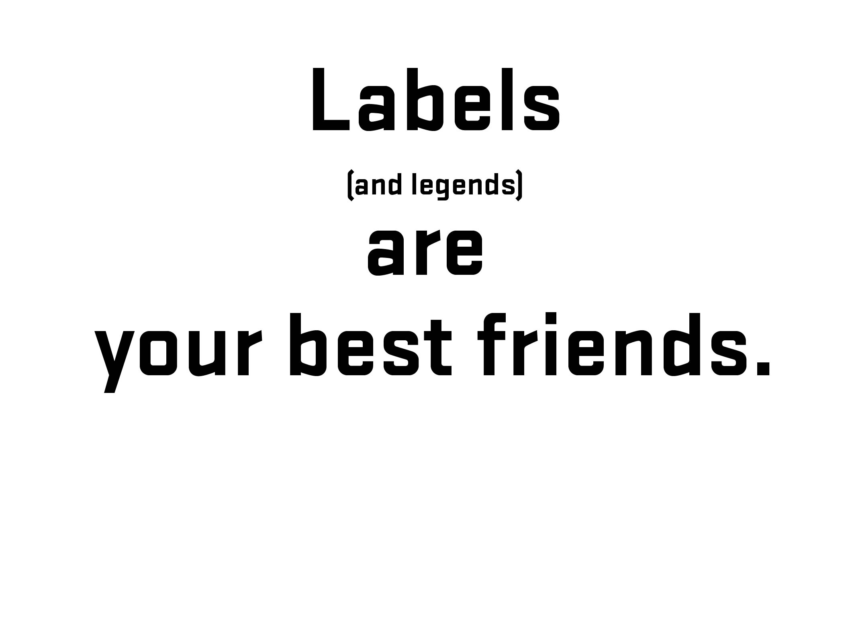

Notes:
Before going further – 1) explain what labels are and 2) what is that difference between placeholder and labels (and why that is important)

Slide 34
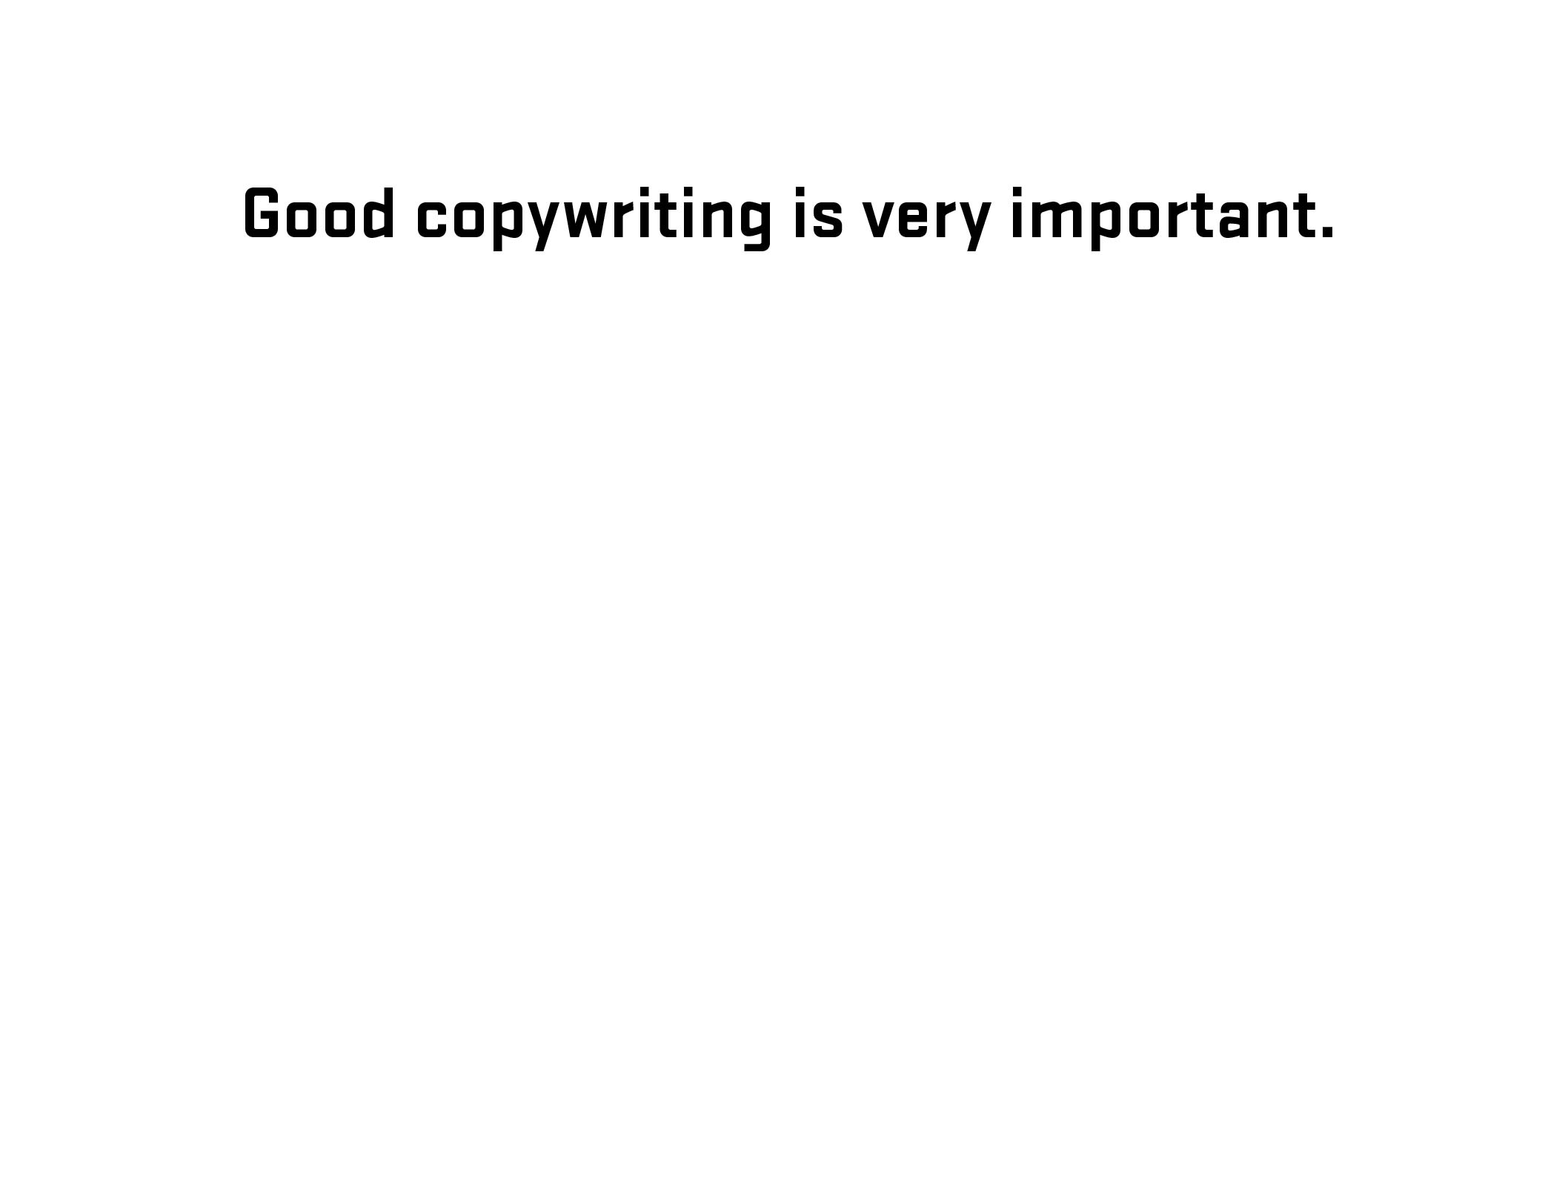
Notes:
Diversion – side note about good writing for labels (copywriting)

Slide 35
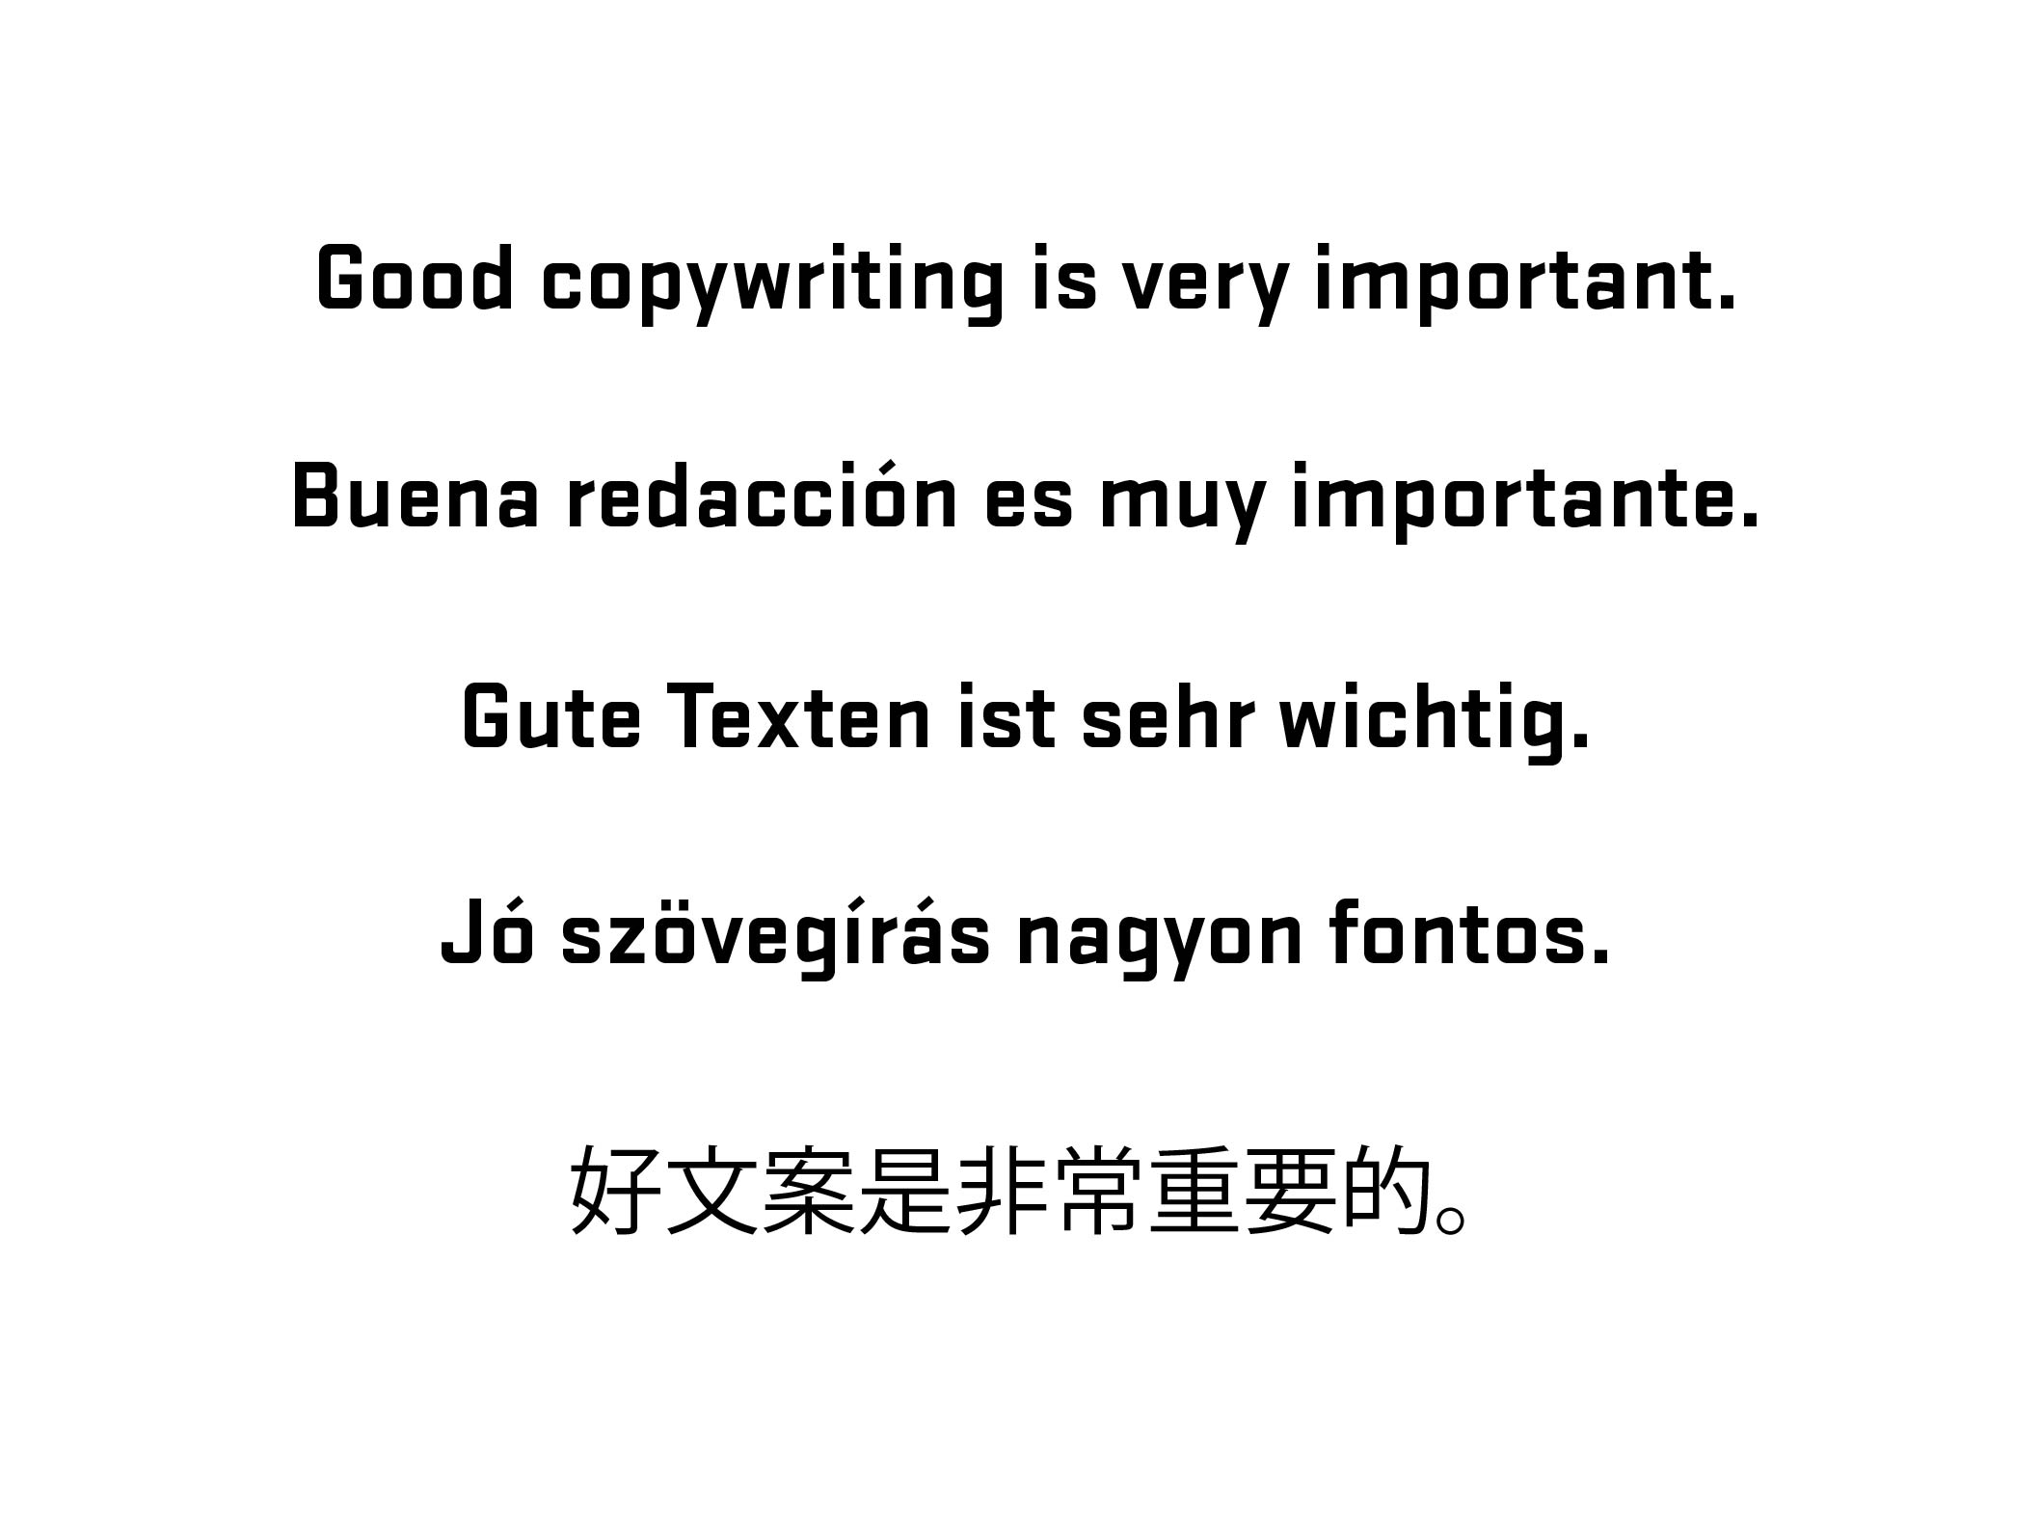
Notes:
Diversion – side note about good writing for labels (copywriting)

Slide 36
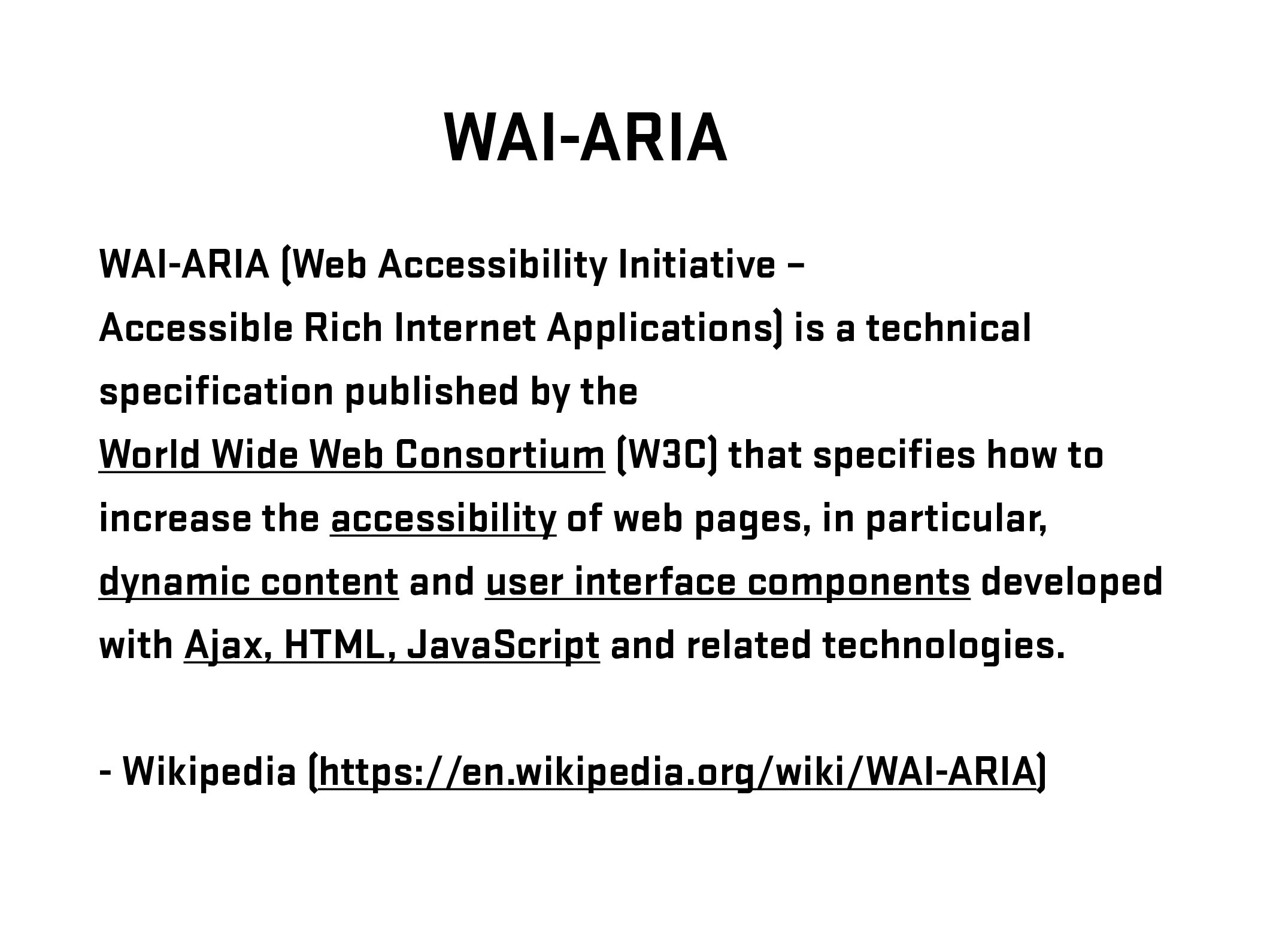
Notes:
Brief overview of history/explanation. Go further if needed – refer to W3C.
Need list of resources for audience

Slide 37
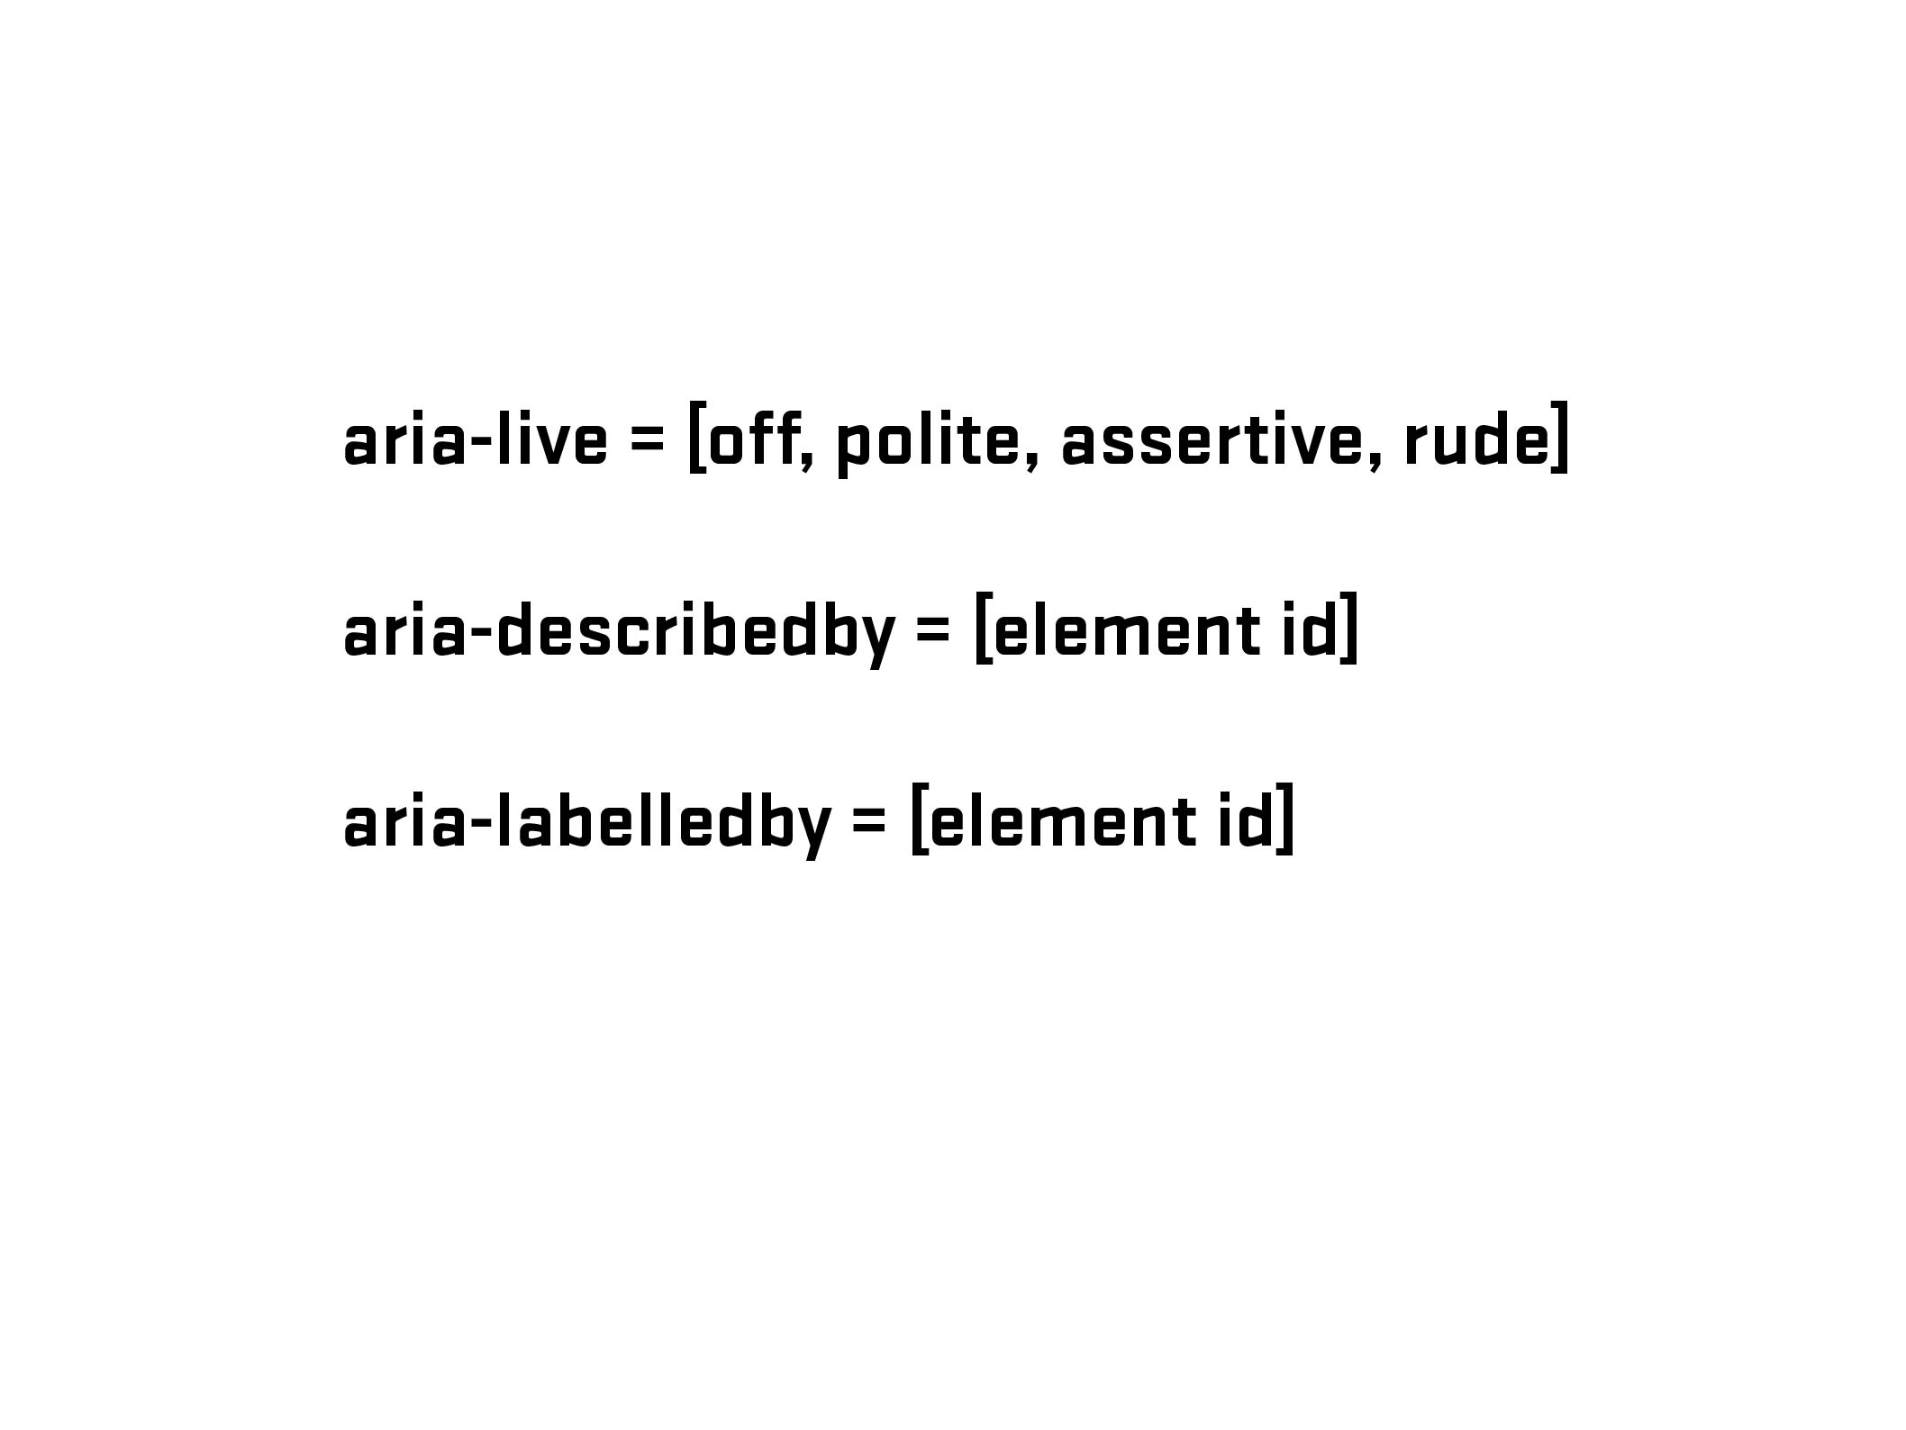

Slide 38
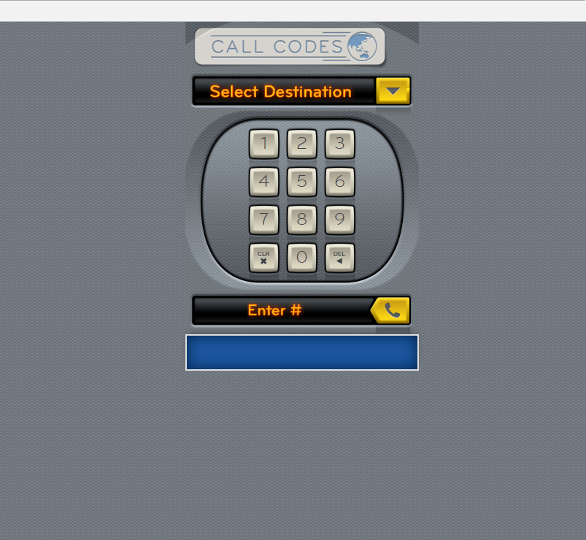

Slide 39
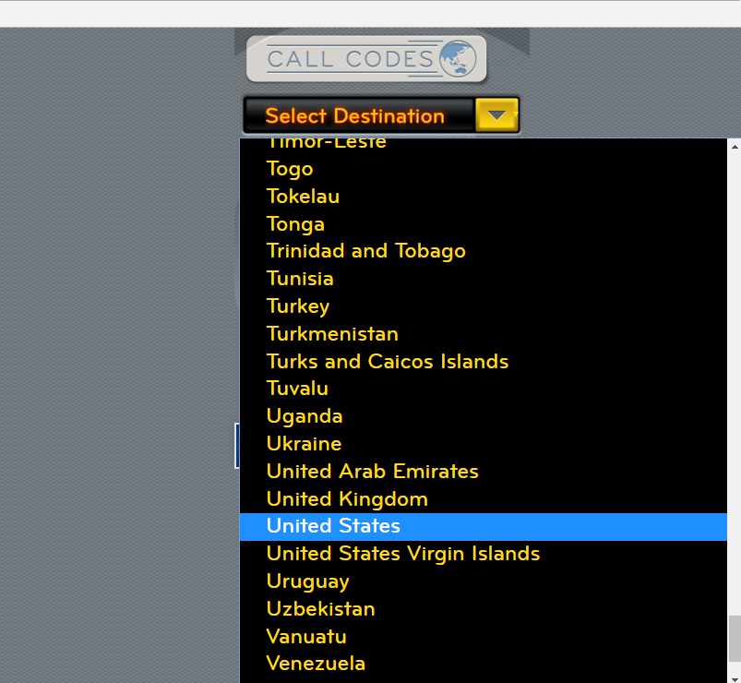

Slide 40
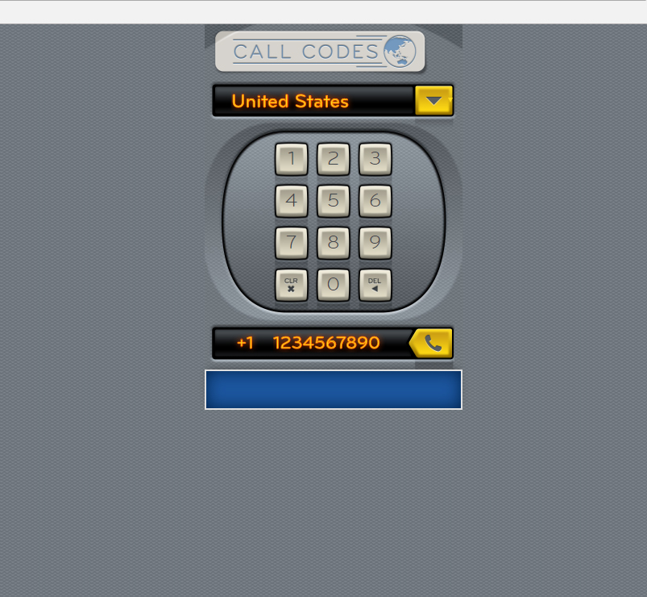

Slide 41
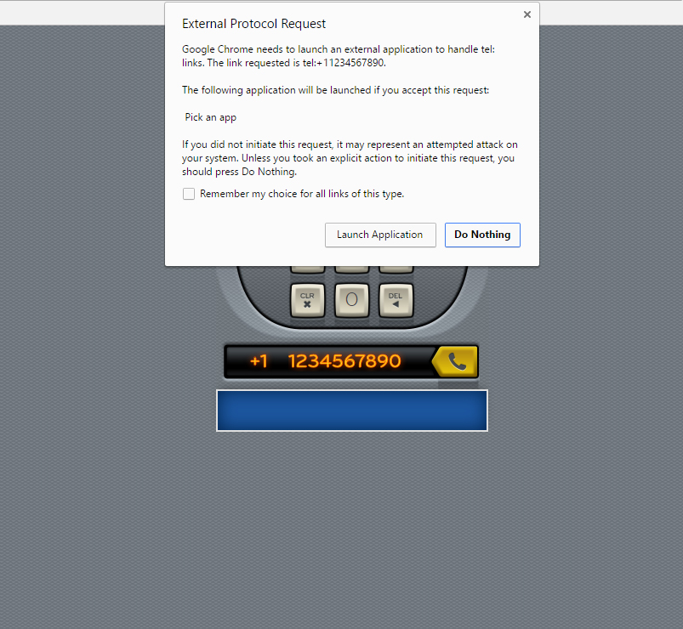

Slide 42
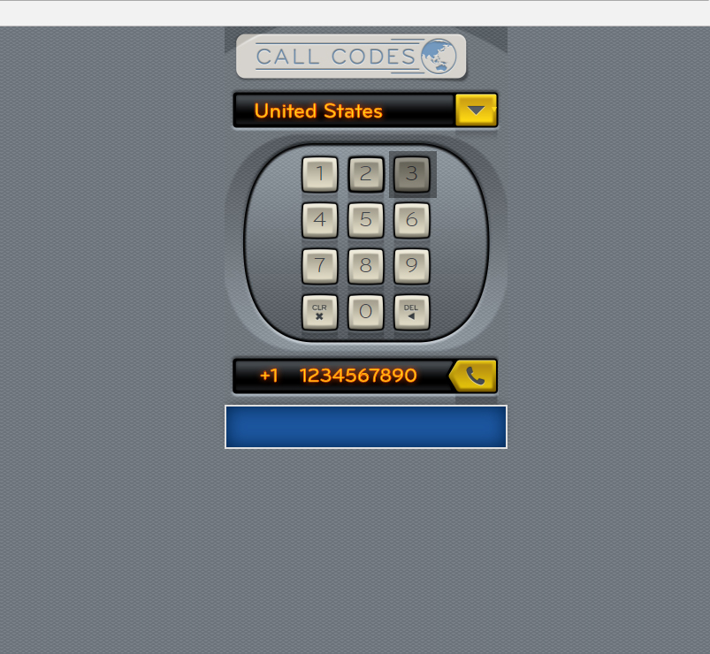
<span>3</span>

Slide 43
<button type="button">3</button>

Slide 44
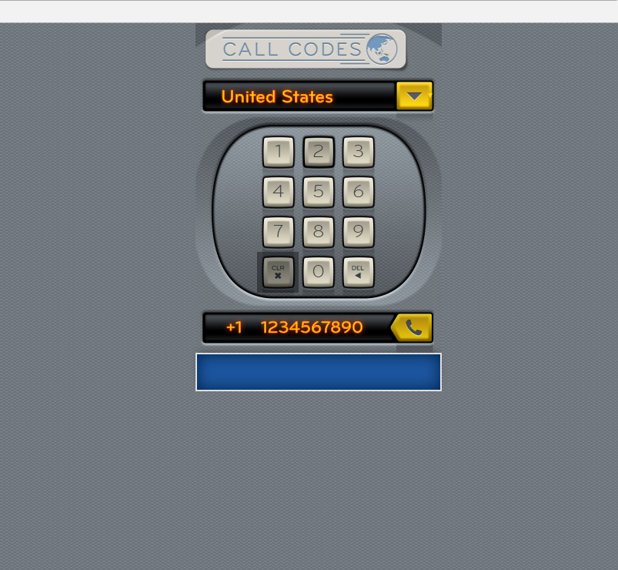
<span class="clearButton"><img src="files/images/icons/icon-clear-key-touch.png" width="17" height="18" alt="Clear"></span>

Slide 45
<input type="reset" class="clearButton" value="Clear Number">

Slide 46
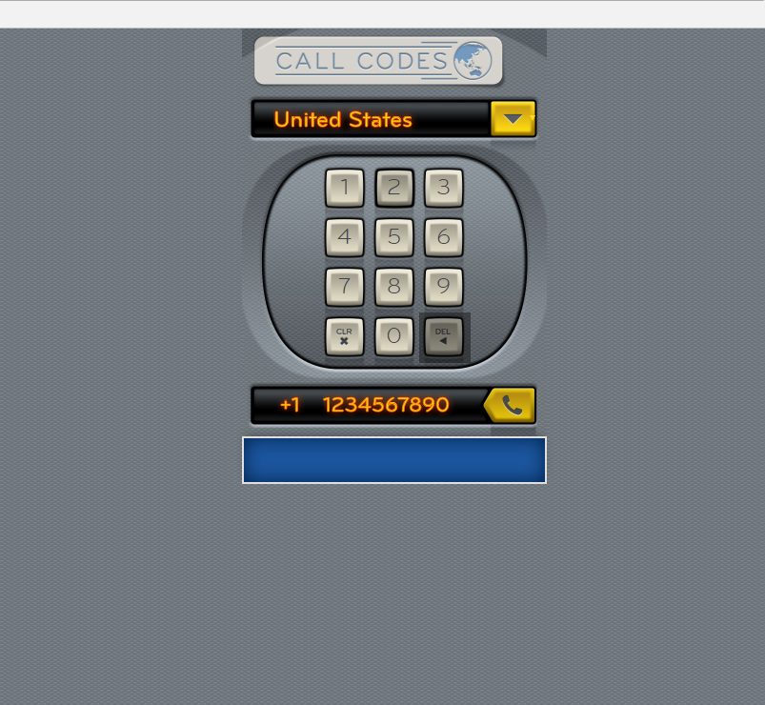
<span class="deleteNumber"><img src="files/images/icons/icon-del-key-touch.png" width="17" height="18" alt="<"></span>

Slide 47
<button type="button" class="deleteNumber">Delete Numbers</button>

Slide 48
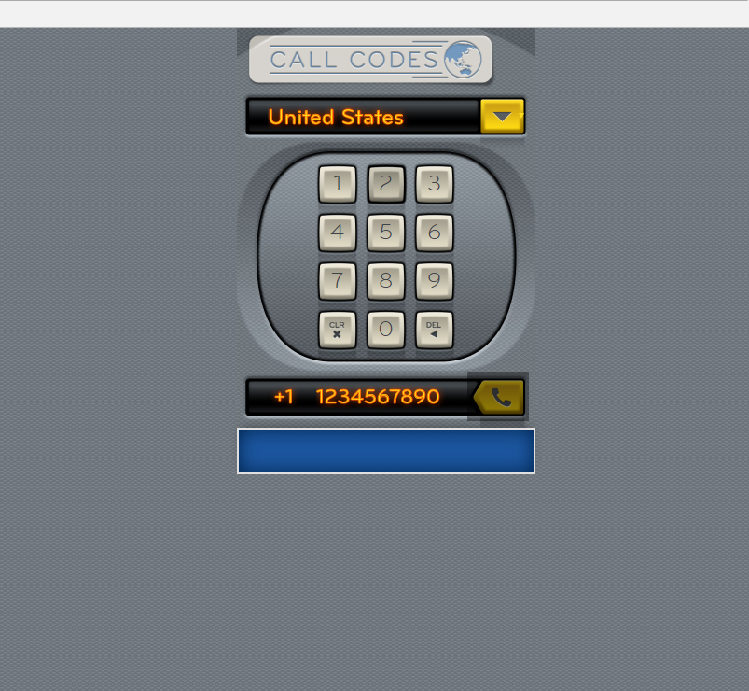
<a href="#" class="callButton ui-link"></a>

Slide 49
<input type="submit" name="call" value="Call Number" class="callButton">

Slide 50
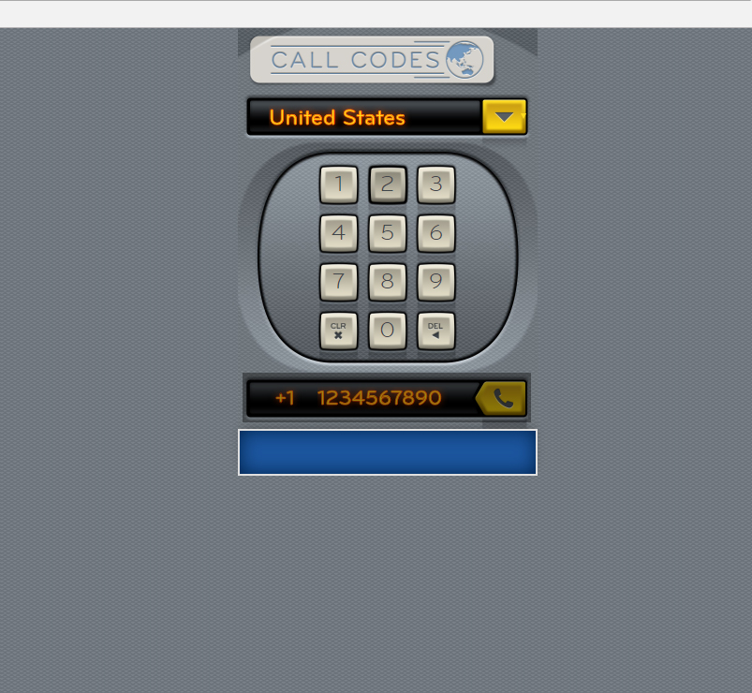
JS - Add aria-live=“polite” when the full number (10 characters) has been reached – indicating number is ready to be called

Slide 51
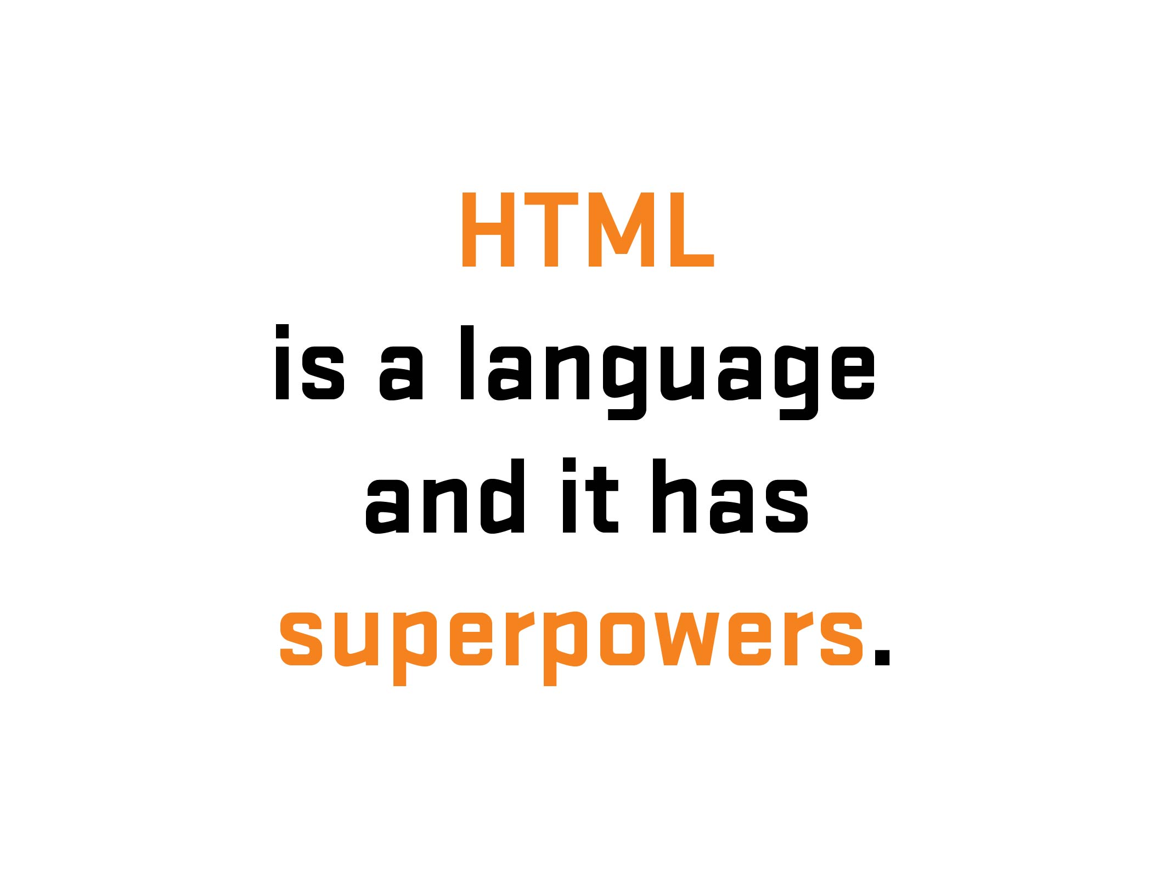

Slide 52
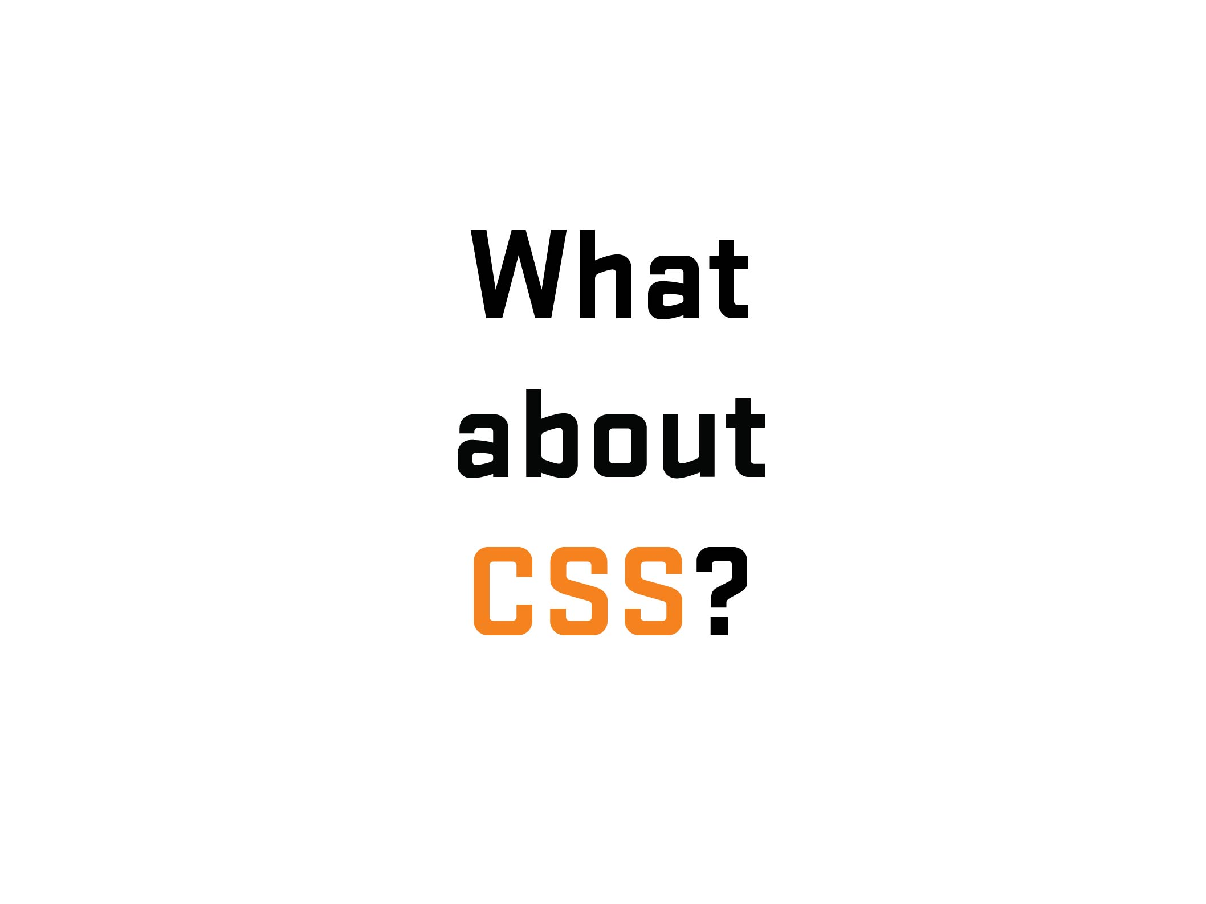

Slide 53


Slide 54
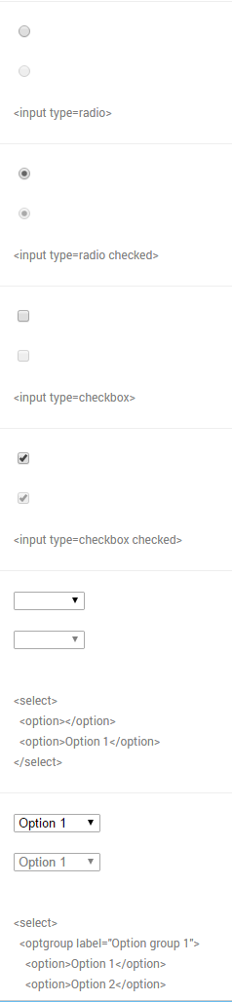
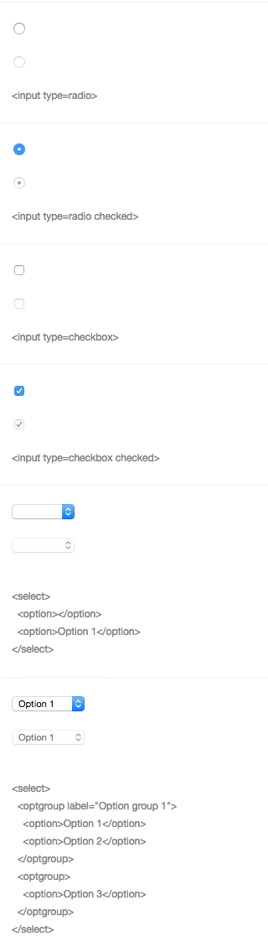
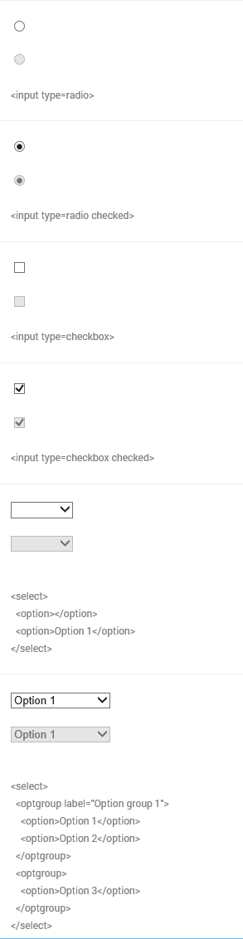



Notes:
Differences of form UI’s among browsers/platforms

Slide 55
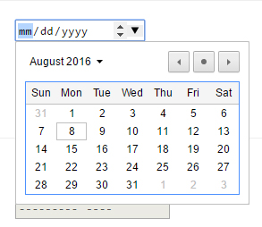
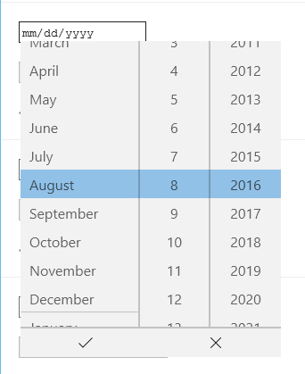


Notes:
Another example – Date input (different look/functionality/UI) – Desktop
Go to nativeformelements.com for brief demo

Slide 56
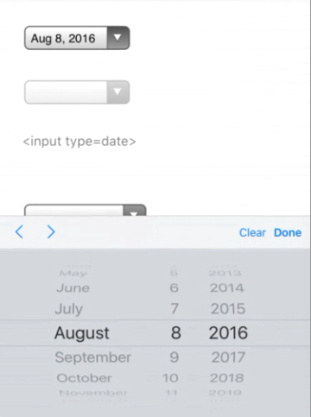



Notes:
Another example – Date input (different look/functionality/UI) - Mobile

Slide 57


Slide 58


Slide 59

Notes:
Before going further – 1) explain what labels are and 2) what is that difference between placeholder and labels (and why that is important)

Slide 60



Slide 61


Slide 62


Slide 63


Slide 64

Notes:
youGo – travel insurance for under 30 crowd/Cover-More

Slide 65
Notes:
youGo/unlucky explanation – Visual (Choice #1)
Form with four set of radio buttons – no submit
(demo form)
Go to youGo site for demo - http://yougotravelinsurance.com.au/

Slide 66

Notes:
youGo/unlucky explanation – Visual/Code (Choice #1)

Slide 67

Notes:
youGo/unlucky explanation – Visual/Code (Choice #1)

Slide 68

Notes:
youGo/unlucky explanation – Visual/Code (Choice #1)

Slide 69

Notes:
youGo/unlucky explanation – Visual/Code (Choice #1)

Slide 70


Notes:
youGo/unlucky explanation – Visual/Code (Choice #1)

Slide 71


Slide 72


Slide 73


Slide 74


Slide 75


Slide 76


Slide 77


Slide 78


Slide 79


Slide 80


Slide 81



Slide 82

Notes:
Solved problem with two prong/server page approach – one desktop/one mobile. Which is an viable option (see McGrane/adaptive solutions). But at the time, it had hiccups (serving wrong page, etc.). Not a mess but not an ideal (responsive) solution.

Slide 83

Notes:
If I had a chance, what would I do…
So I wrote some notes…

Slide 84


Notes:
First thing, change the codebase (responsive/reduced JS/a11y?)
Allowed for direct data input (no JS)
Single code base (responsive)
A11y???

Slide 85

Notes:
Going back to the base – information language

Slide 86


Slide 87


Slide 88


Slide 89


Slide 90


Slide 91

Notes:
No JS in data entry – used for display/toggle

Slide 92
.ui-countryselector input[type="radio"]
+ label ~ div.columns {
overflow: hidden;
float: none;
position: absolute;
clip: rect(0,0,0,0);
width: 100%;
height: 0;
margin: 0;
padding: 0;
}

Slide 93
If a region is not selected,
hide related countries

Slide 94
If a region is selected,
show related countries

Slide 95
.ui-countryselector input[type="radio"]:checked
+ label ~ div.columns {
position: static;
height: auto;
}

Slide 96
.ui-countryselector input[type="radio"] + label ~ div.columns { overflow: auto; }

Slide 97

.ui-countryselector input[type="radio"]:checked + label ~ div.columns { float: left; height: 384px; }
Notes:
Note – hard to do due to bugs. Adjacent bug in both iOS (“+” didn’t work) and Android (needed fix). Thankfully, fixed in more recent versions.

Slide 98

Notes:
I found out during QA testing and was able to remove or work around some of the barriers.

Slide 99

Notes:
No excuse for not testing – getting problems out of the way. For the initial work, even had to test for Android 2.3…But the way, a moment of silence….

Slide 100


Slide 101


Slide 102


